Slide 1
Using Your Phone
as a Camera
Meghan White
Adult Services Librarian
February 26, 2019

Slide 2
Overview
Camera Basics
Techniques
Activity
Resources

Slide 3
Your Phone’s Camera
General Overview
What to Expect
Limitations

Slide 4
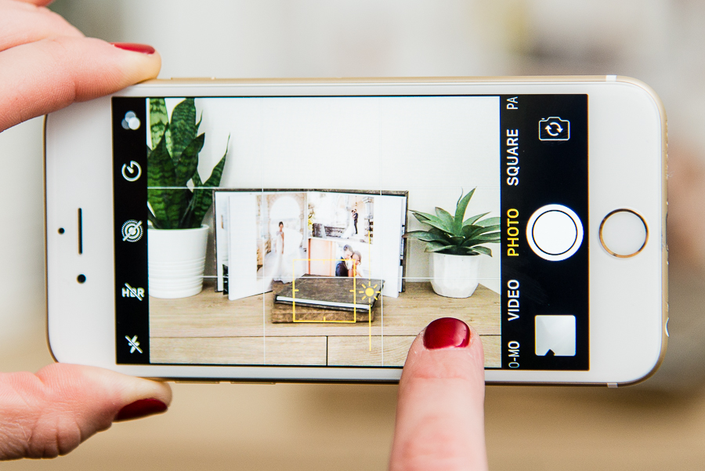
http://www.nationsphotolab.com/blog/mobile-photography-tips/

Slide 5
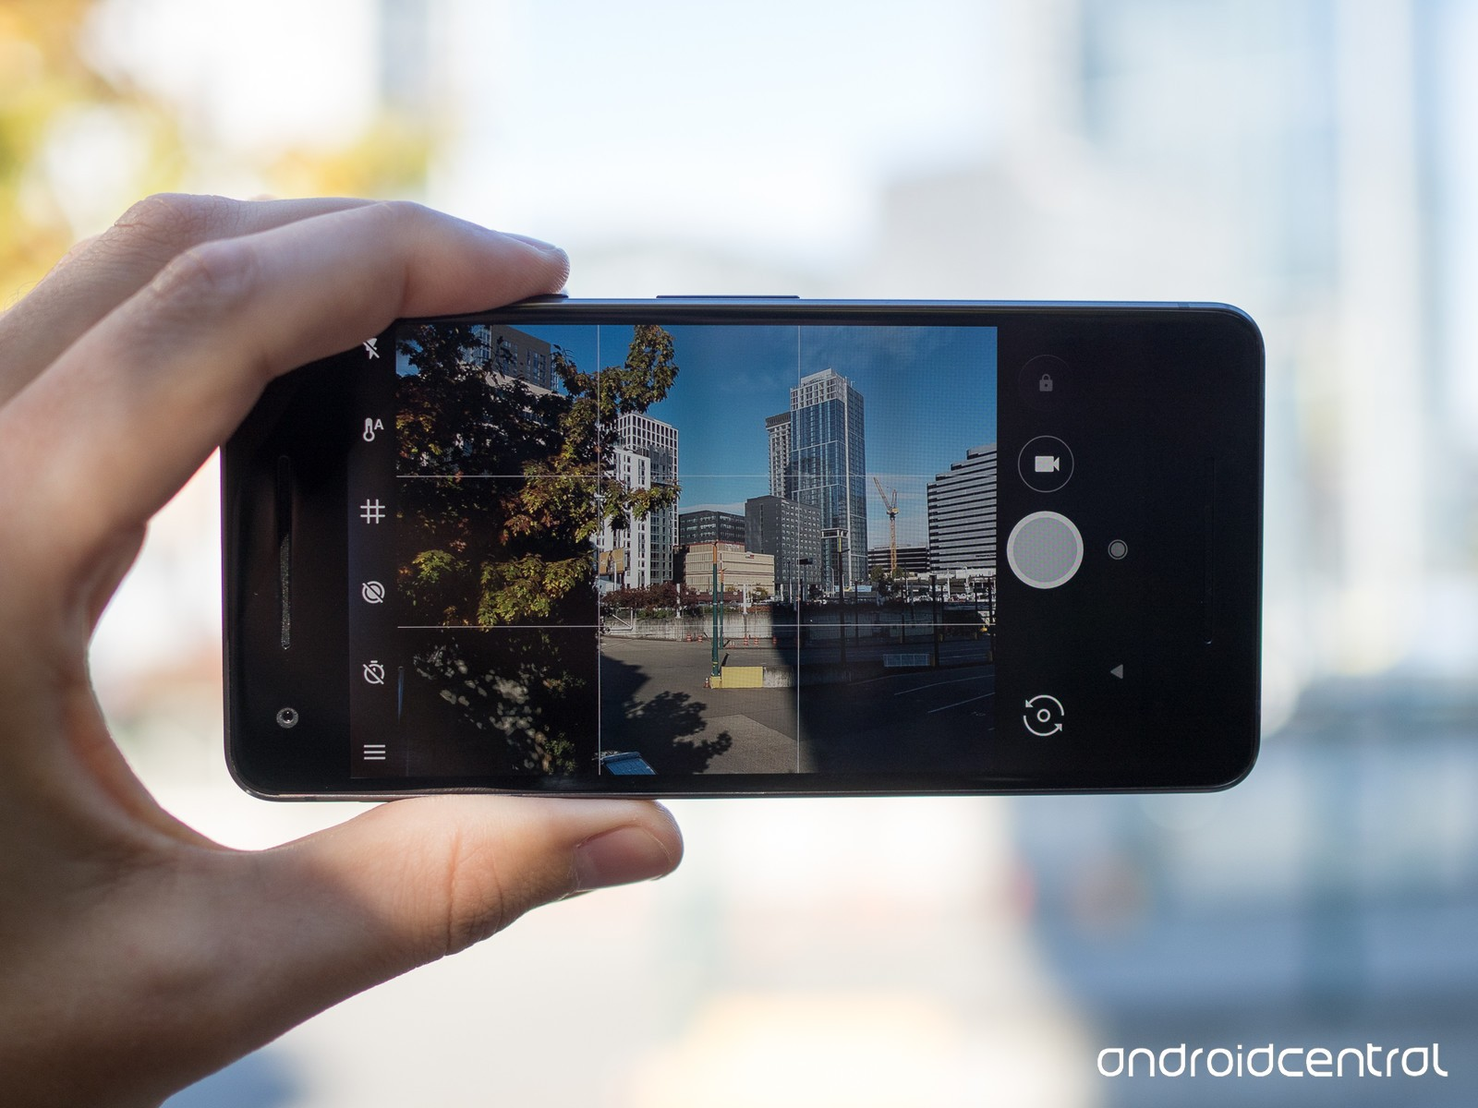
https://www.androidcentral.com/android-p-features-we-love-better-camera-experience
Notes:
https://www.androidcentral.com/android-p-features-we-love-better-camera-experience

Slide 6
Photography Techniques
Rule of Thirds
Lighting
Zoom

Slide 7
Rule of Thirds
Grid
Orientation
Focus

Slide 8
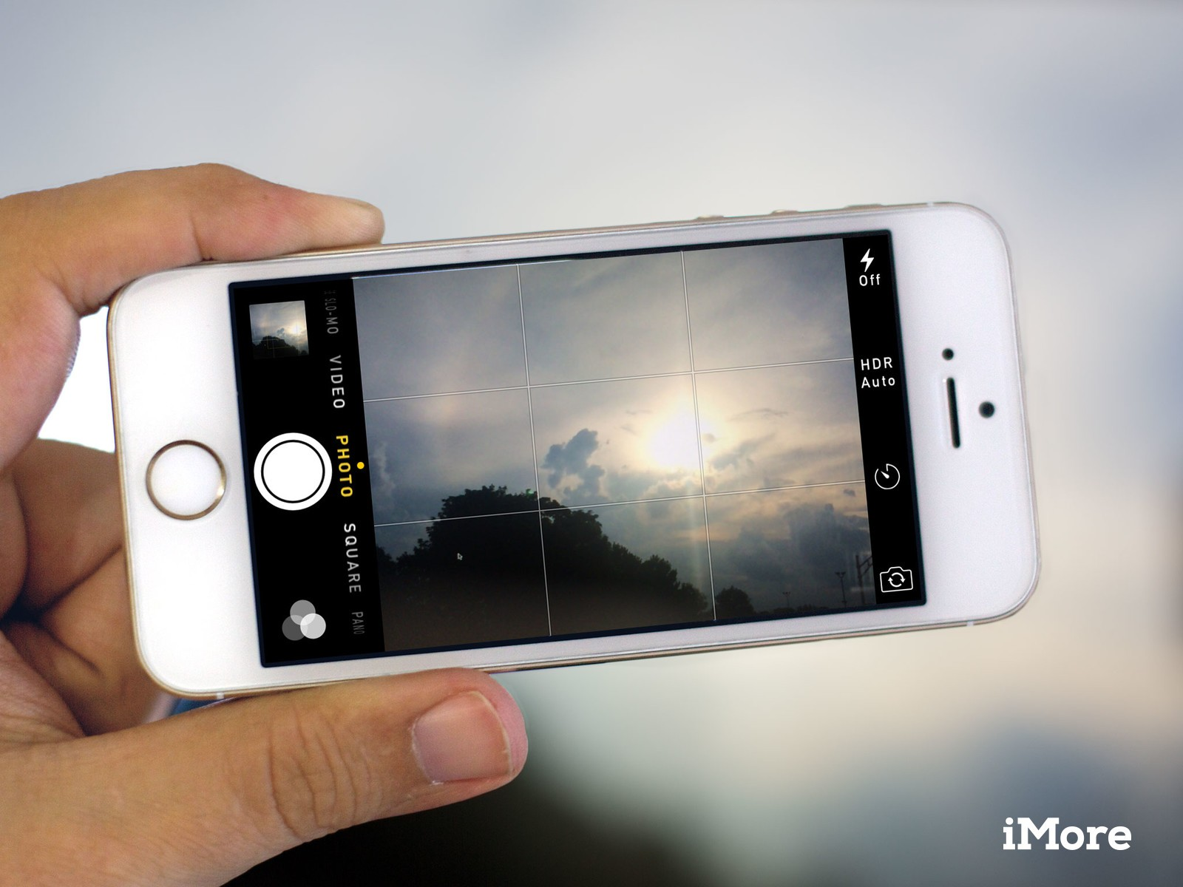
https://www.imore.com/how-to-rule-thirds-photos-iphone
Notes:
https://www.imore.com/how-to-rule-thirds-photos-iphone

Slide 9
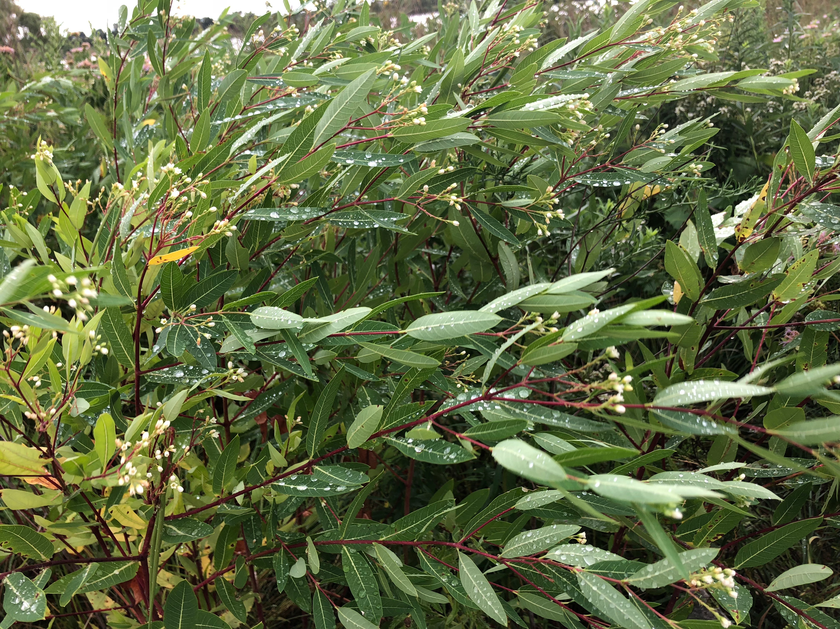
Notes:
Movement, Texture, Depth

Slide 10
Notes:
Movement, Texture, Depth

Slide 11
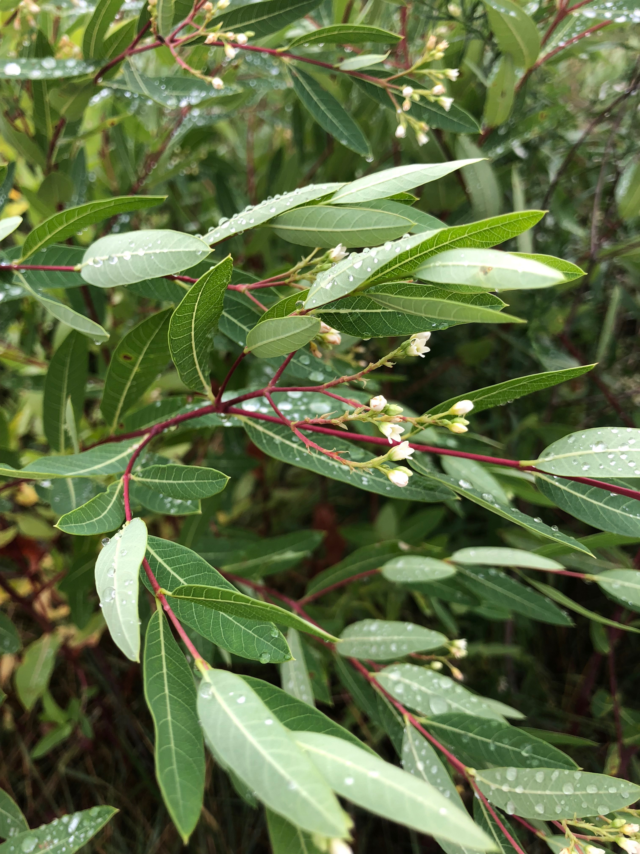

Slide 13
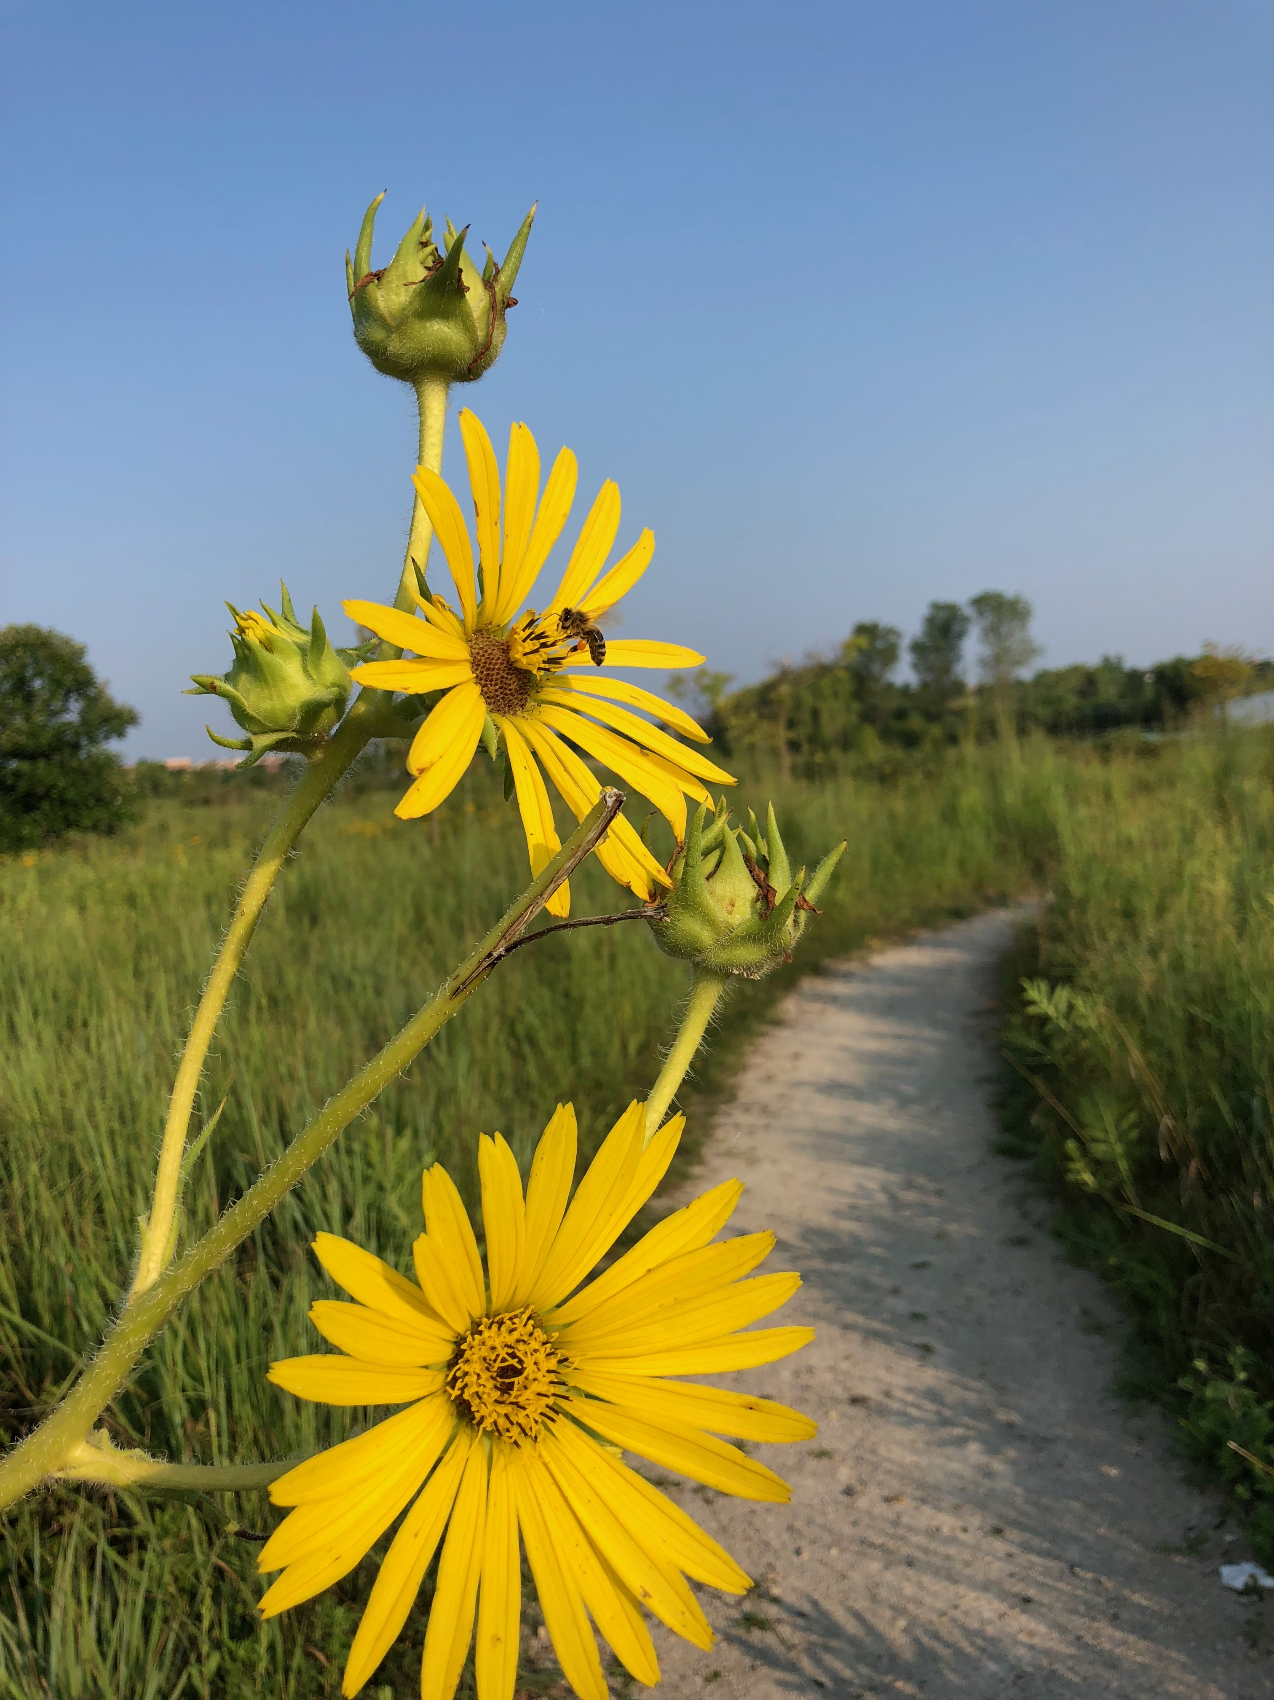

Slide 15
Lighting
Angles
Natural vs. Artificial
Adjusting Brightness

Slide 16
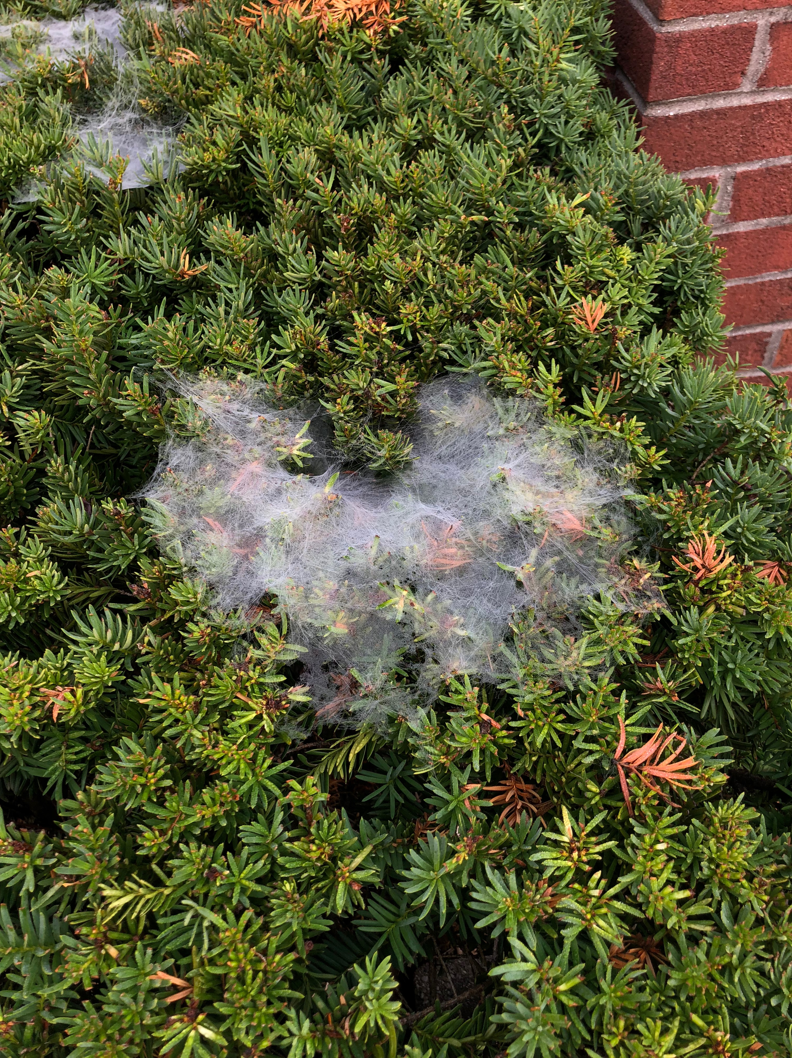

Slide 17
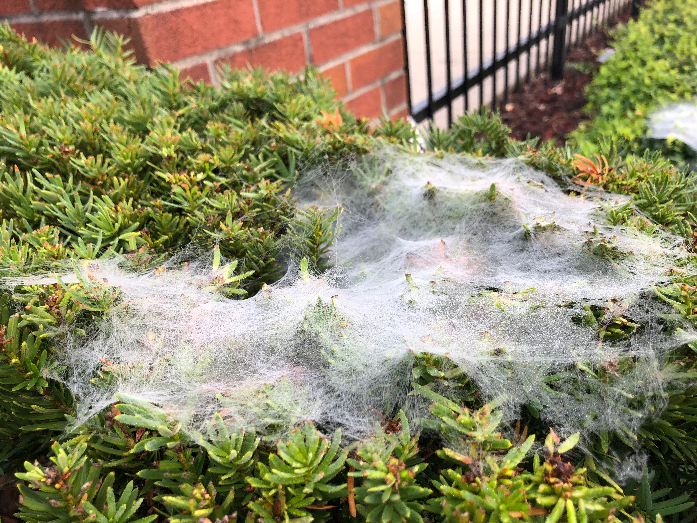

Slide 18
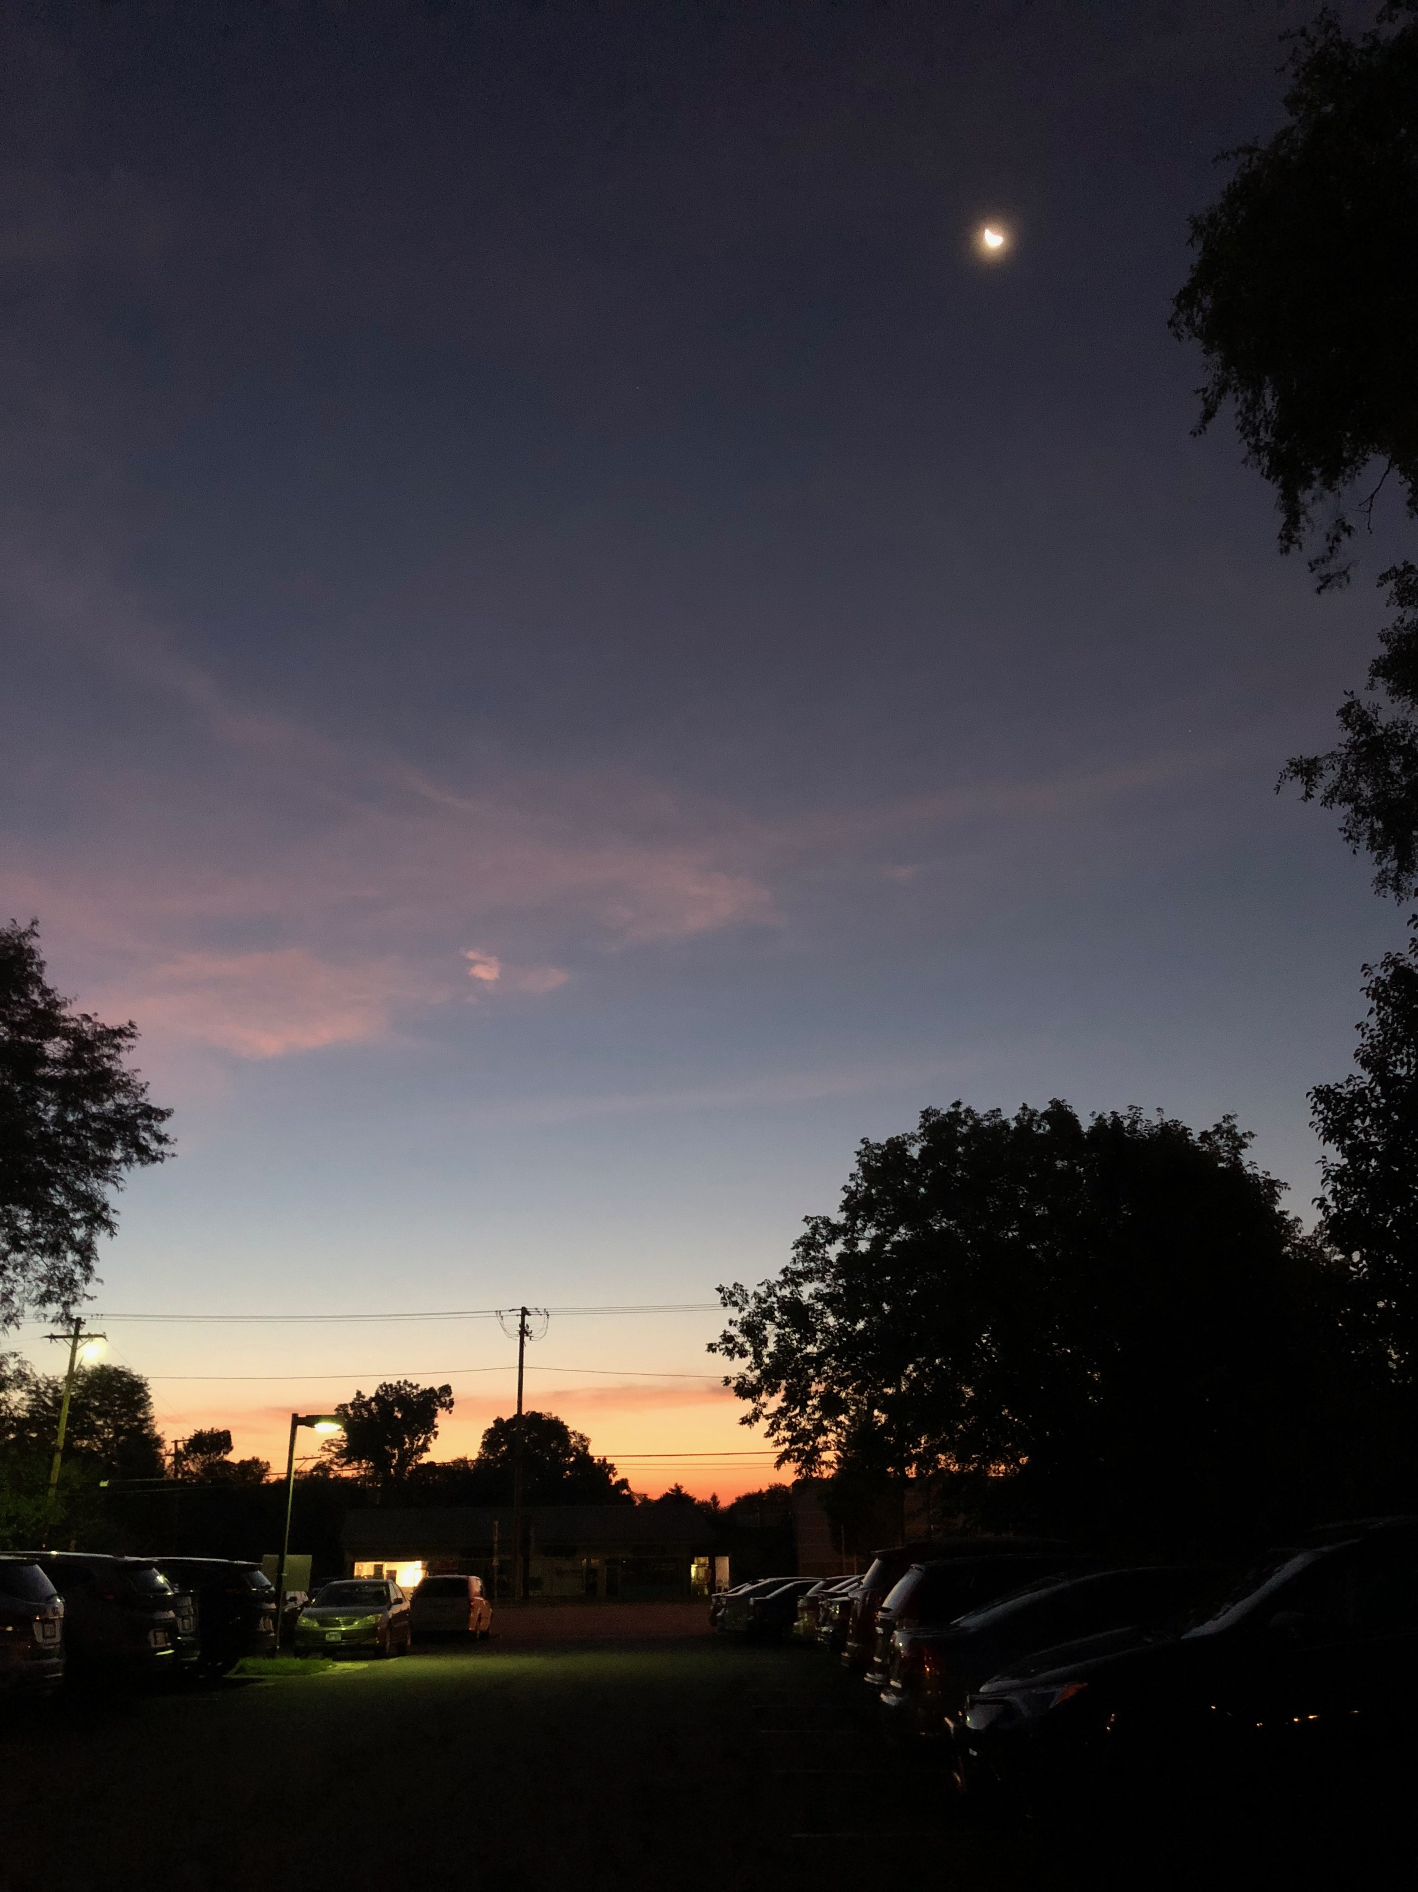

Slide 19
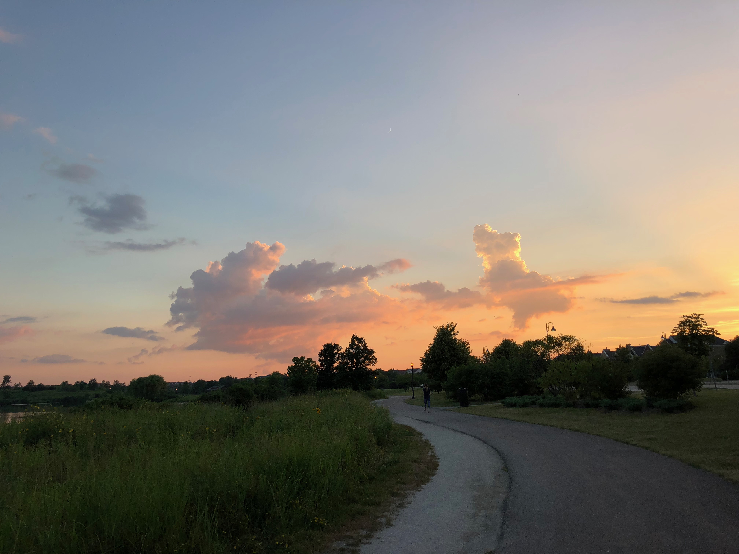
Notes:
Weighting an image

Slide 20
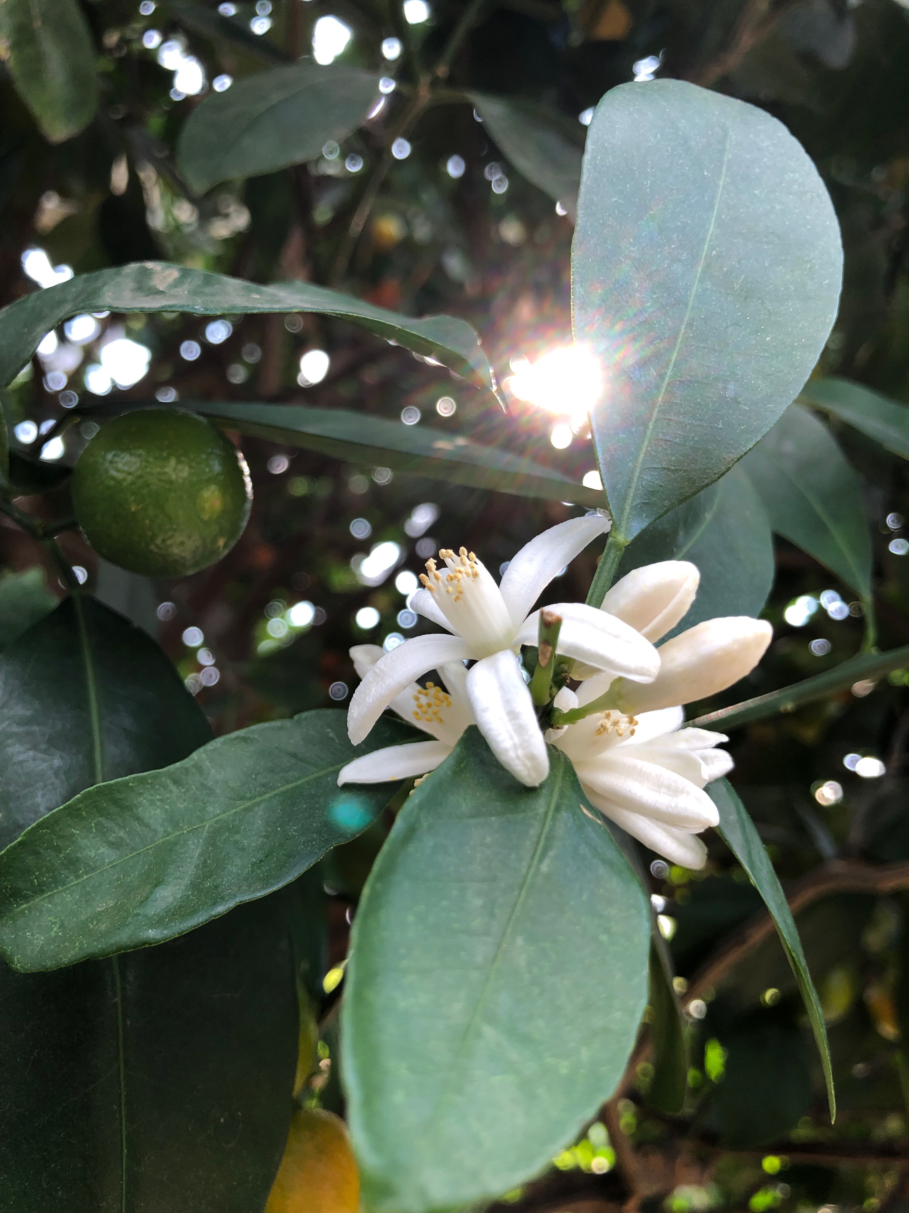

Slide 21
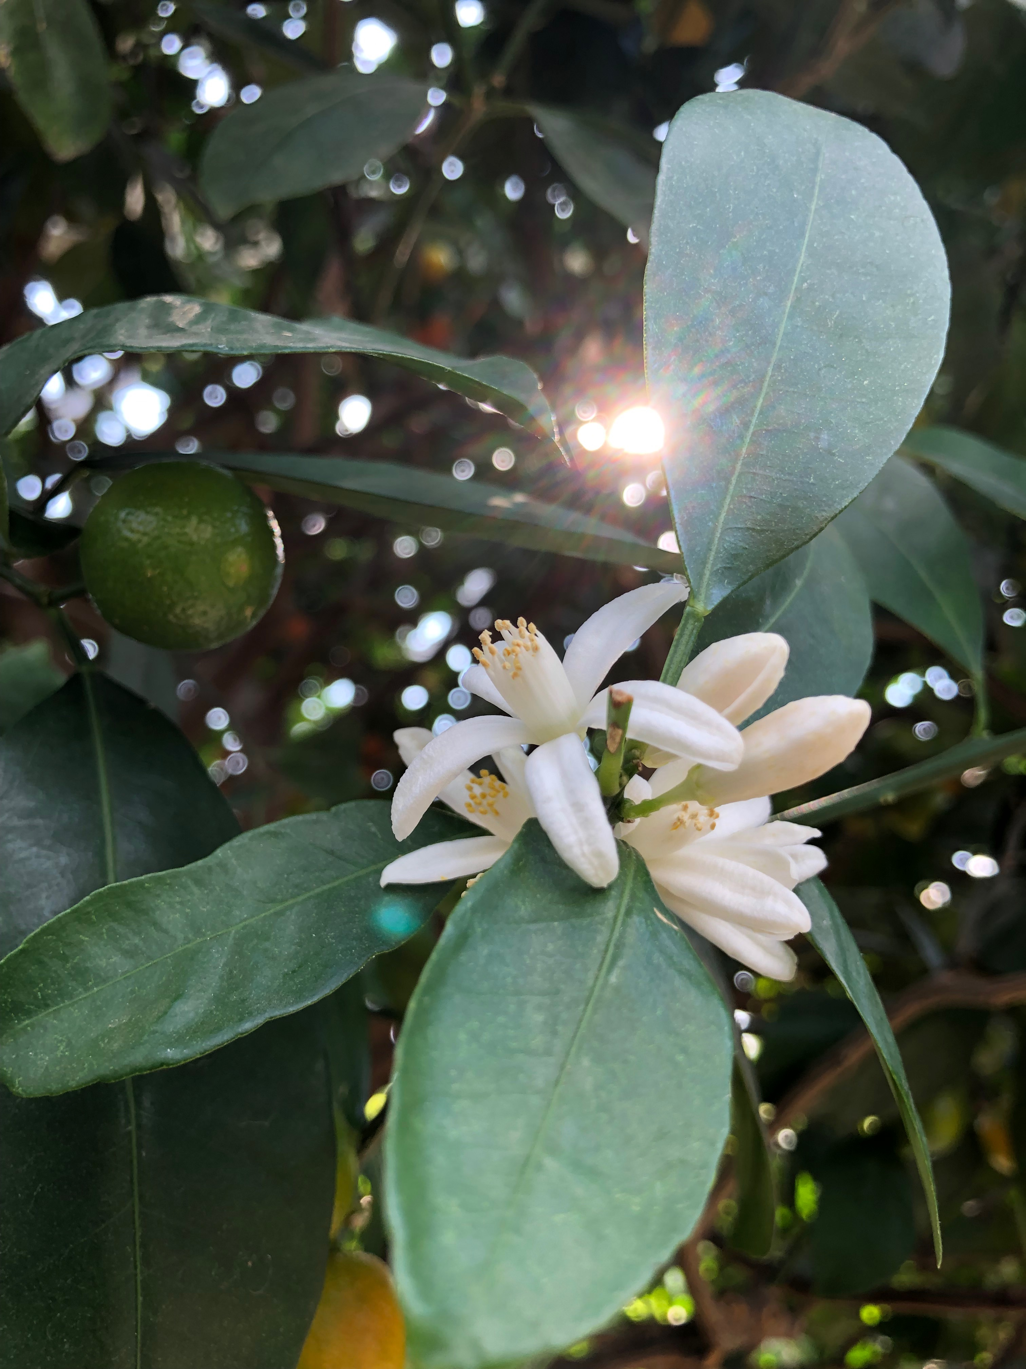
Notes:
HDR – High Definition Resolution

Slide 22
Zoom vs. Close Up
Optical Zoom vs. Digital Zoom
Limitations of Zoom

Slide 23
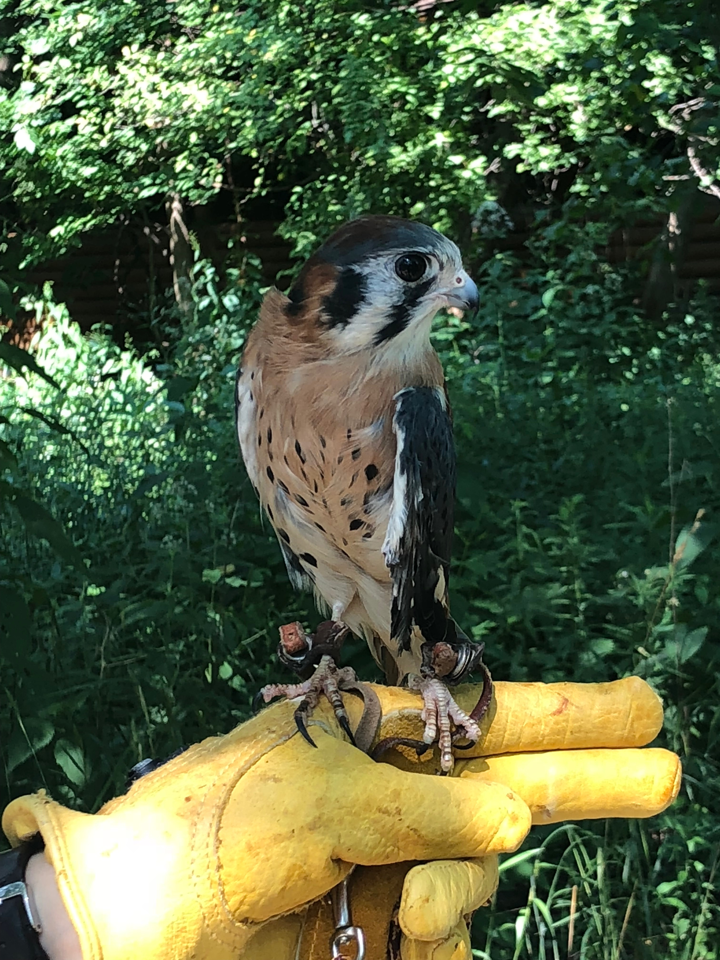

Slide 24
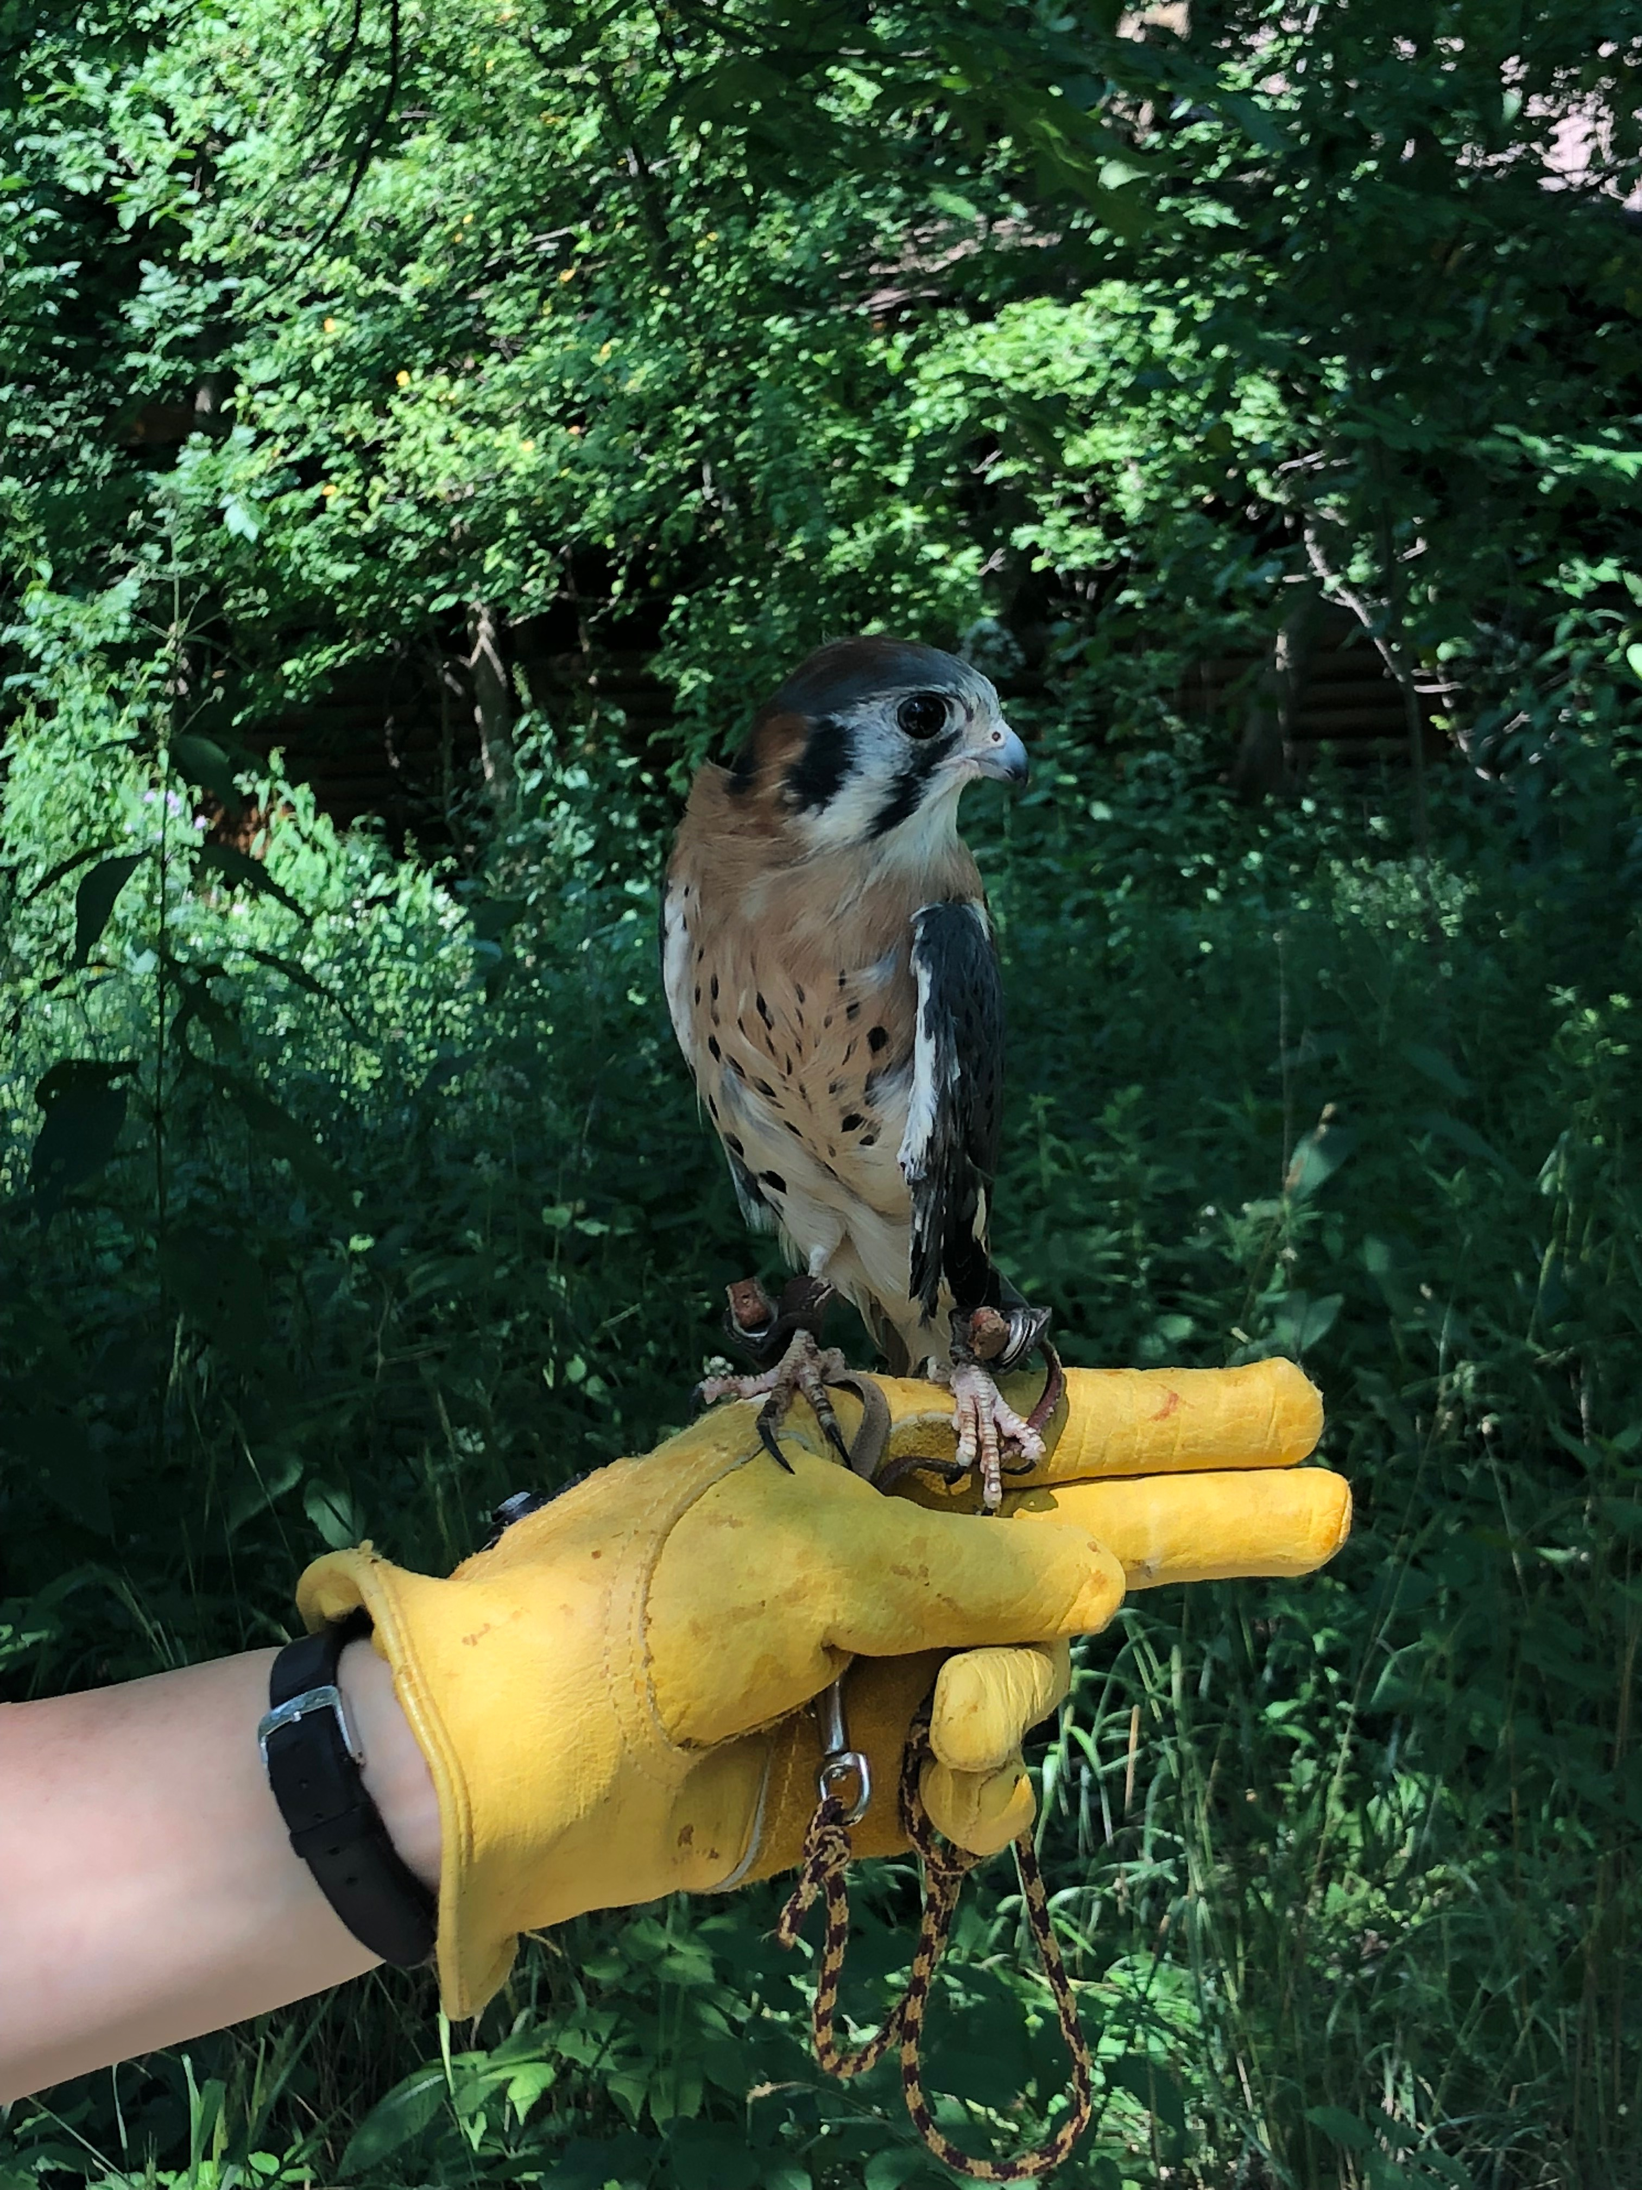

Slide 25
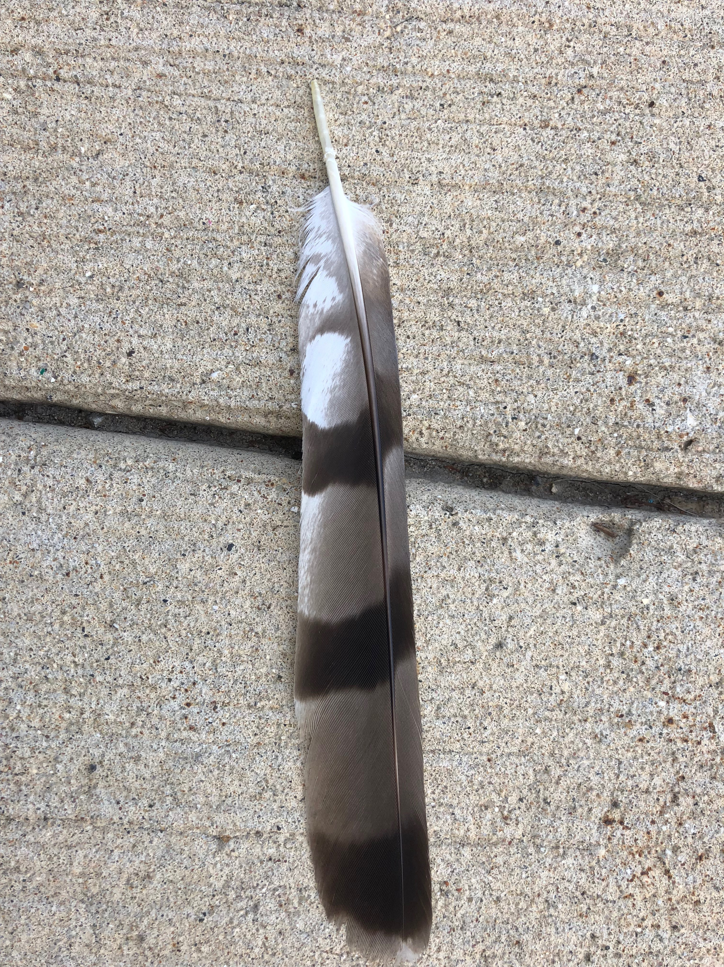

Slide 26
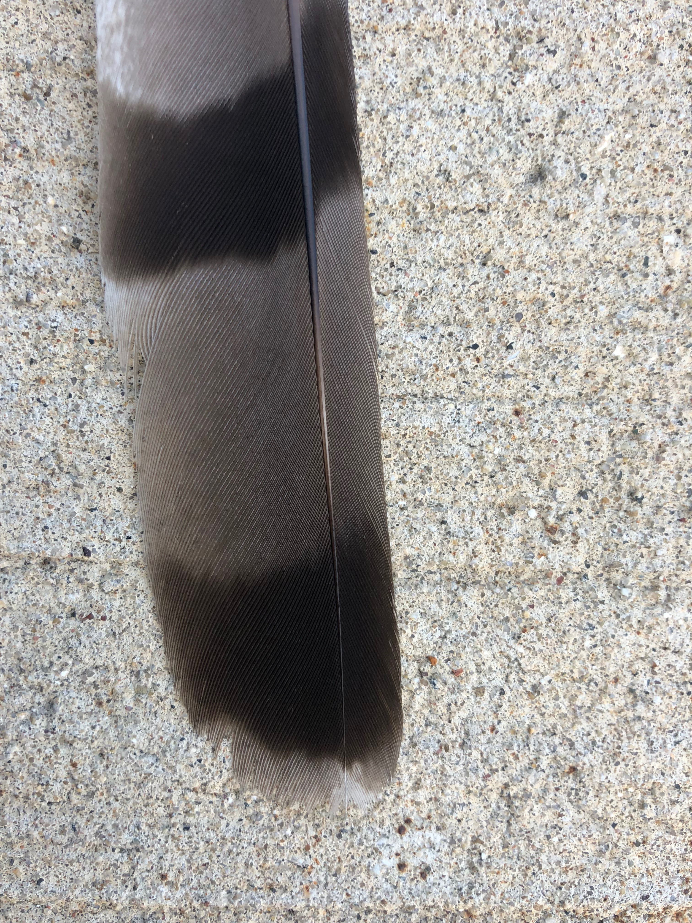

Slide 27
Using Your Phone’s Camera
Activity
Rule of Thirds
Lighting
Zoom vs. Close Up

Slide 28
Finishing Touches
Experimenting
Editing
Sharing
Notes:
365 Project

Slide 29
Experimenting
365 Challenge
Dogwood 52 Week Challenge
Apps for Editing & Sharing
Notes:
https://digital-photography-school.com/12-creative-photography-project-ideas-motivated/

Slide 30
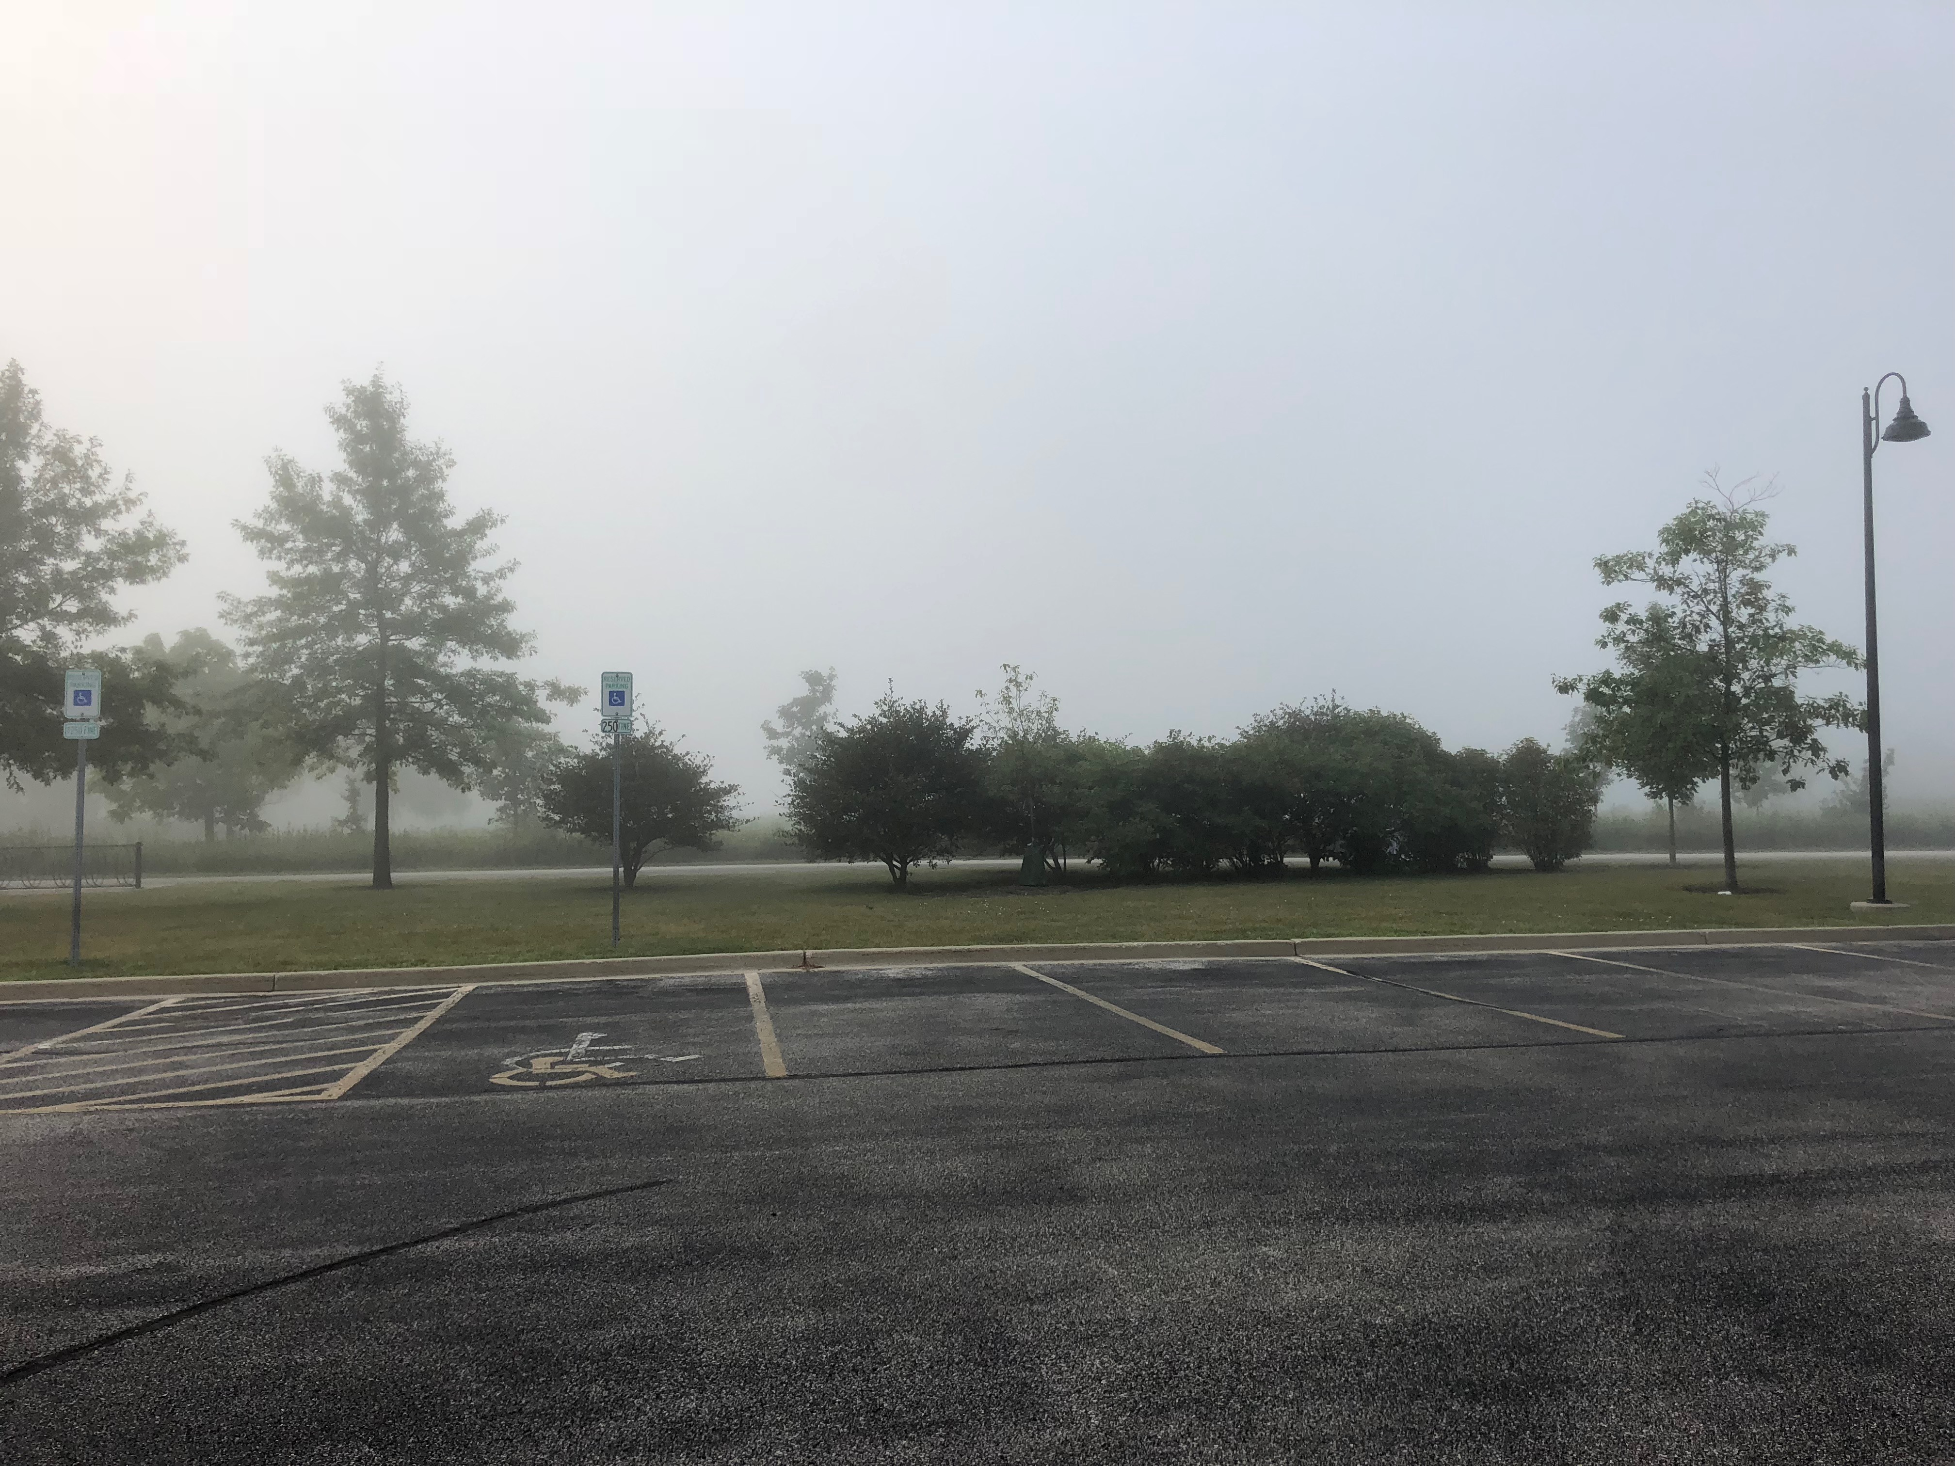

Slide 31
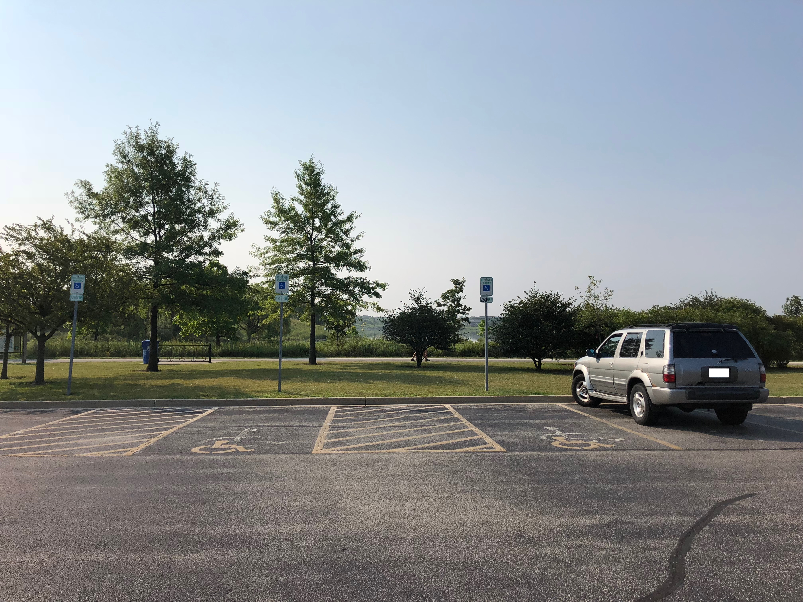

Slide 32
Apps
Editing
Snapseed
Sharing
Instagram
Flickr
Notes:
Snapseed, Instagram, Flickr

Slide 33
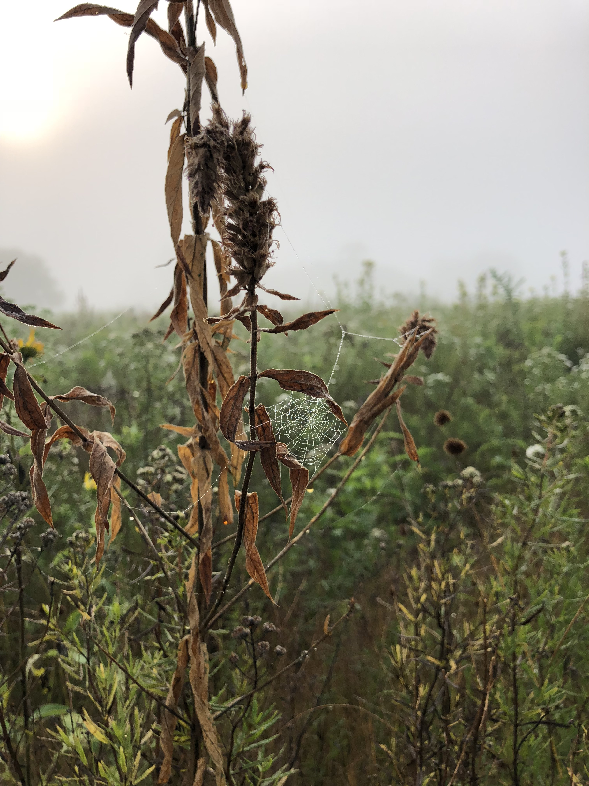

Slide 34
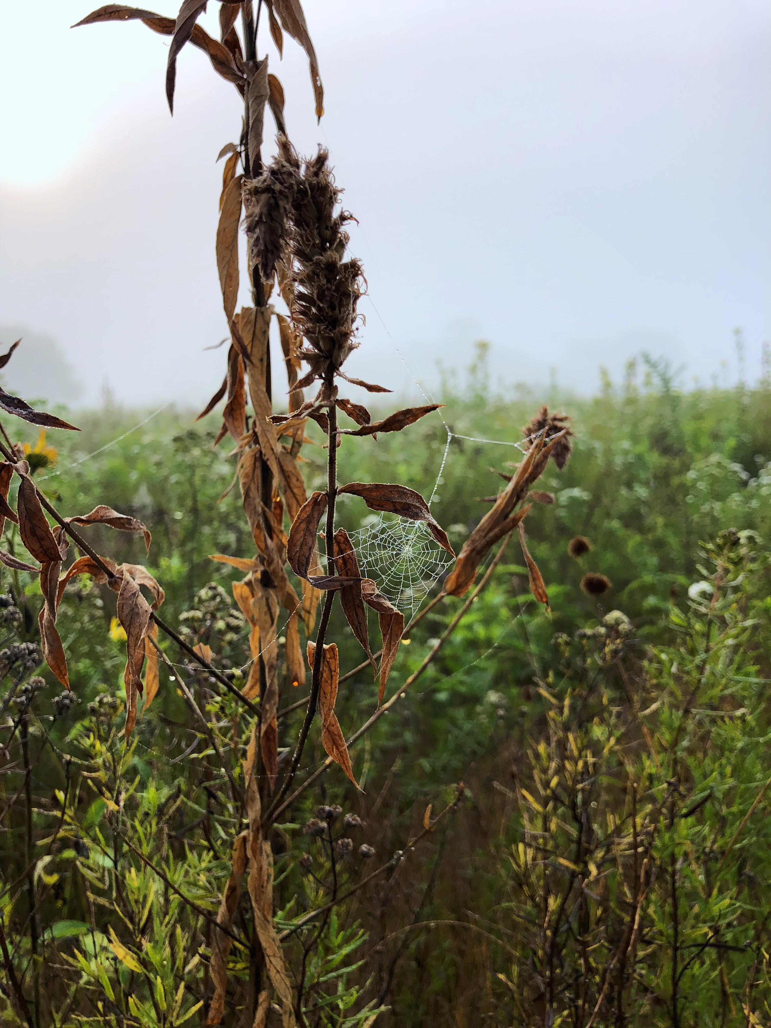

Slide 37
Instagram
Edit & Share Images
Skokie Classes
“Introduction to Instagram”
Lynda.com

Slide 38
Flickr
Digital Photo Albums
Lynda.com

Slide 39
Editing Your Photos
Activity
Choose a photo from our earlier quick photoshoot activity.
Either download Snapseed to edit your photo or use your phone’s built in software to play around with filters, lighting, and temperature of the image.

Slide 40
Resources
Lynda.com
Books
Understanding Composition: The Complete Photographer’s Guide
Creative Photography Lab: 52 Fun Exercises for Developing Self Expression With your Camera
The Enthusiast’s Guide to iPhone Photography: 63 Photography Principles You Need to Know

Slide 41
Thank You
Want a copy of this presentation?
Visit www.skokielibrary.info/handouts
where this presentation will be available
for four weeks.

