Slide 1
Android: Google Maps
Allyson Coan
Adult Services Librarian
acoan@skokielibrary.info
October 18, 2017

Slide 2
What We’ll Cover
Maps vs. Driving
Turn on Location
Find a place
Start navigation
Stop navigation
Navigate
Voice directions
Save your home and work

Slide 3
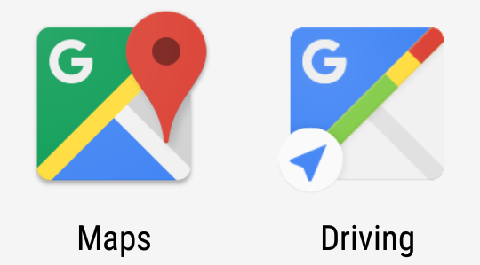
Maps vs. Driving
Notes:
Driving Mode guesses where the user wants to go and helps them navigate there.
Now with just one tap, you’ll know whether you should hit the road or put in some gym time to avoid the gridlock,” a Google spokesperson told VentureBeat.
“With a simple shortcut on your home screen, you’ll head straight into the new driving mode so you’re sure to get where you’re going on the quickest route possible — without entering a destination.
Get information like ETAs, traffic updates, nearby gas prices, and quickest routes to familiar places — like home, work, and recently searched destinations — all from your home screen.”

Slide 4
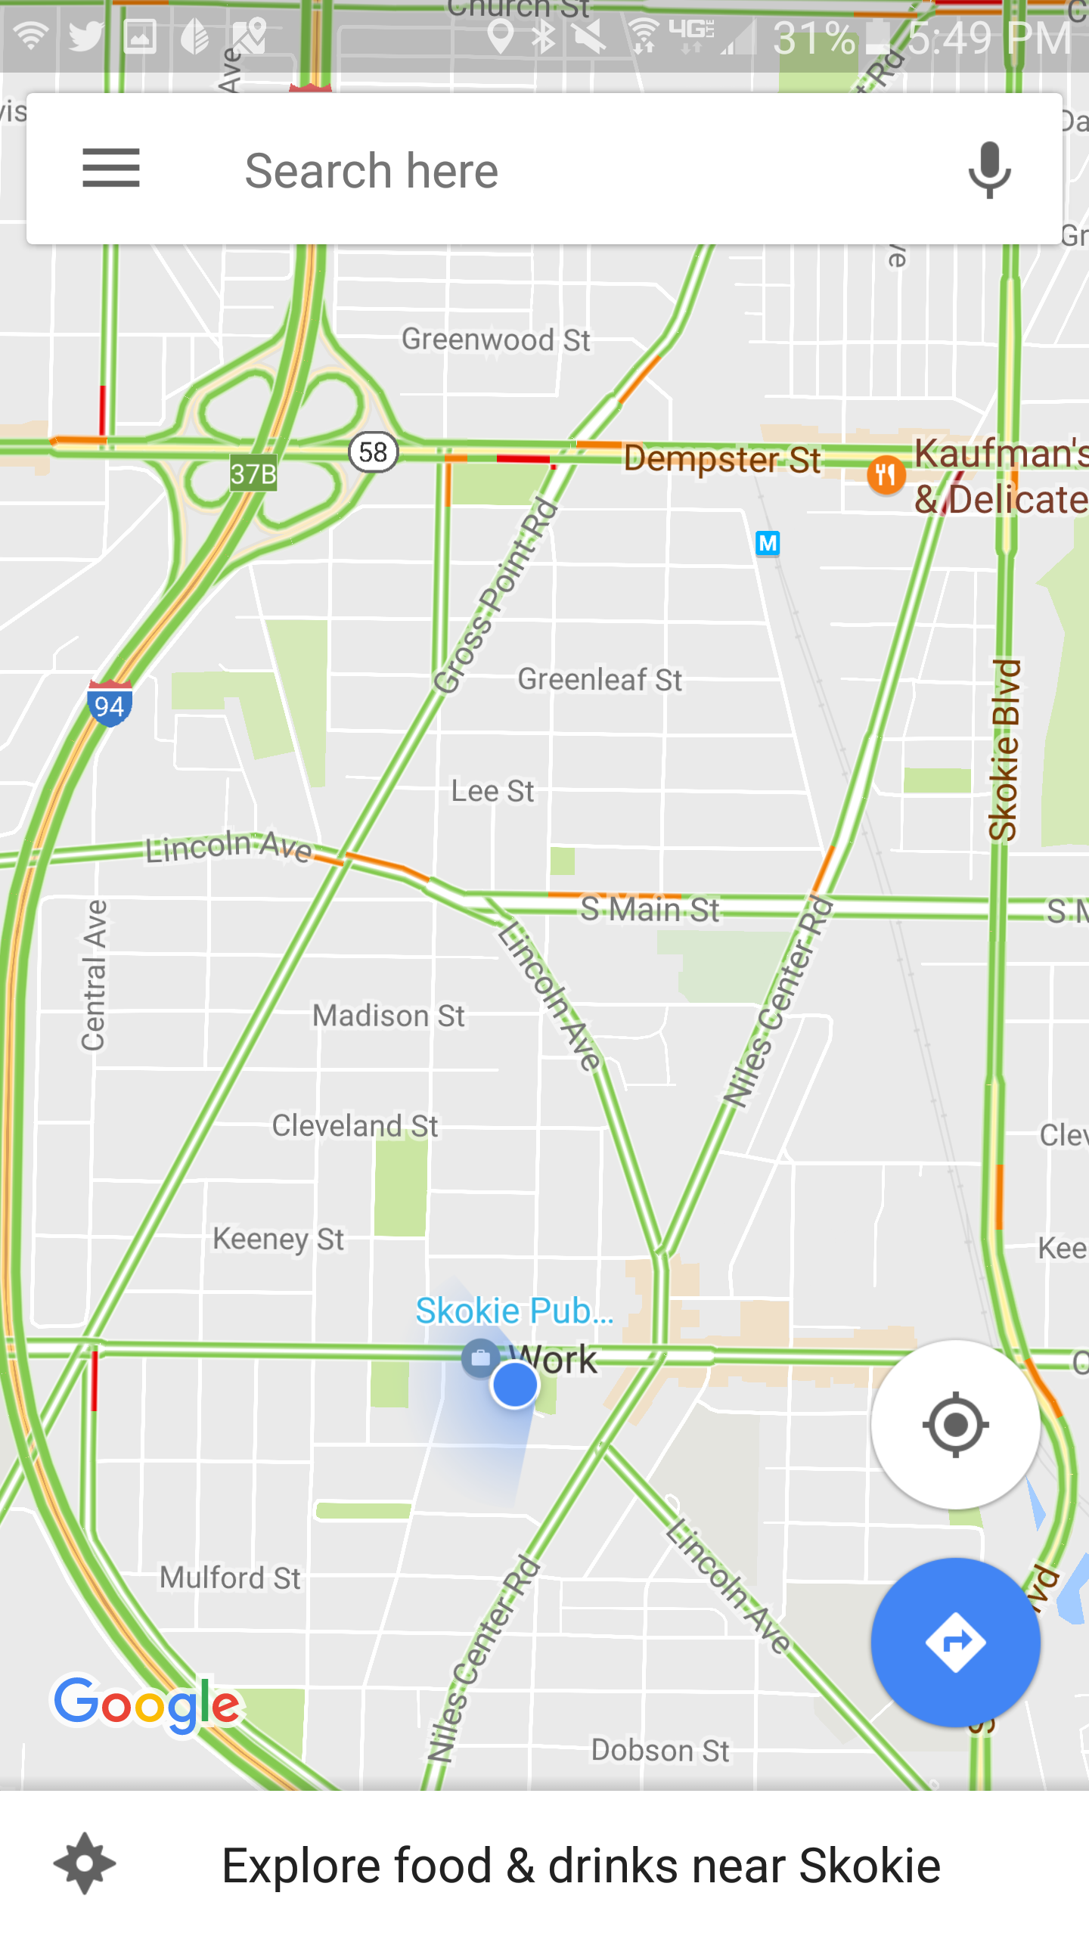
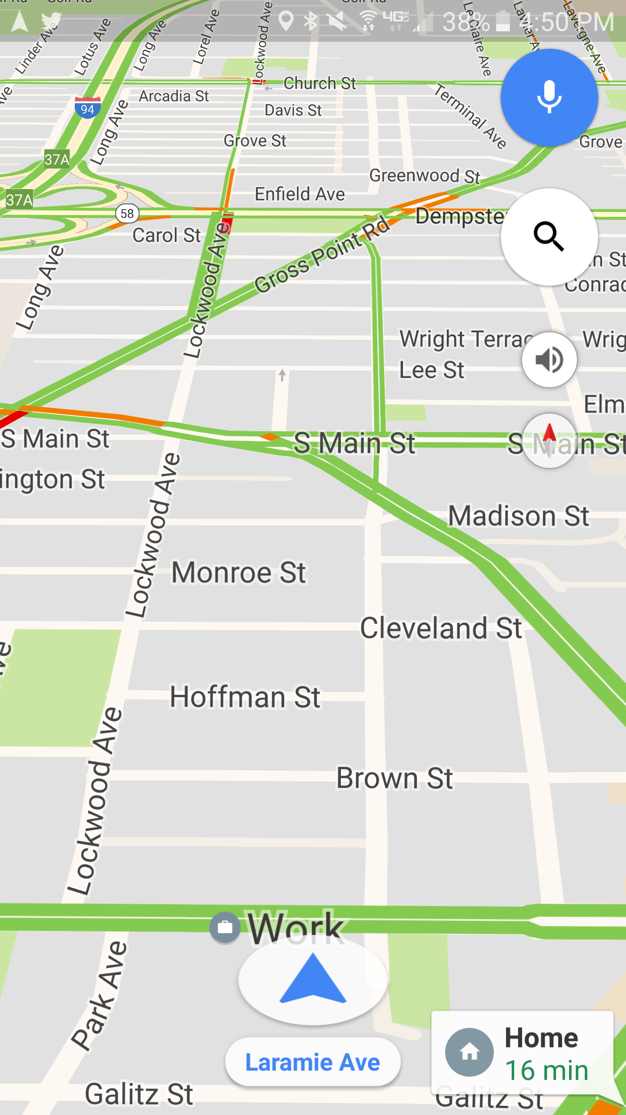
Maps vs. Driving
Notes:
Use Maps for getting directions; Use driving when you’re just driving around
Driving Mode is similar to the Google Now cards that tell you when to leave for an event in your calendar or how long it will take you to get to work and back home.
Those are based off of addresses that are either directly or indirectly provided to Google Now.
This new Driving Mode goes a little further by always showing your home, work, and recently searched addresses.
Destination predictions is based on home / work addresses you have set location history data, and recent search history,” a Google spokesperson told VentureBeat. “Based on location and time of day, Google Map driving mode will show ETAs for recently searched-for destinations.”
Driving Mode is using existing addresses, where you’ve been, what you’ve searched for, your current location, and the time to figure out where you might want to go. That’s both creepy and cool at the same time.

Slide 5
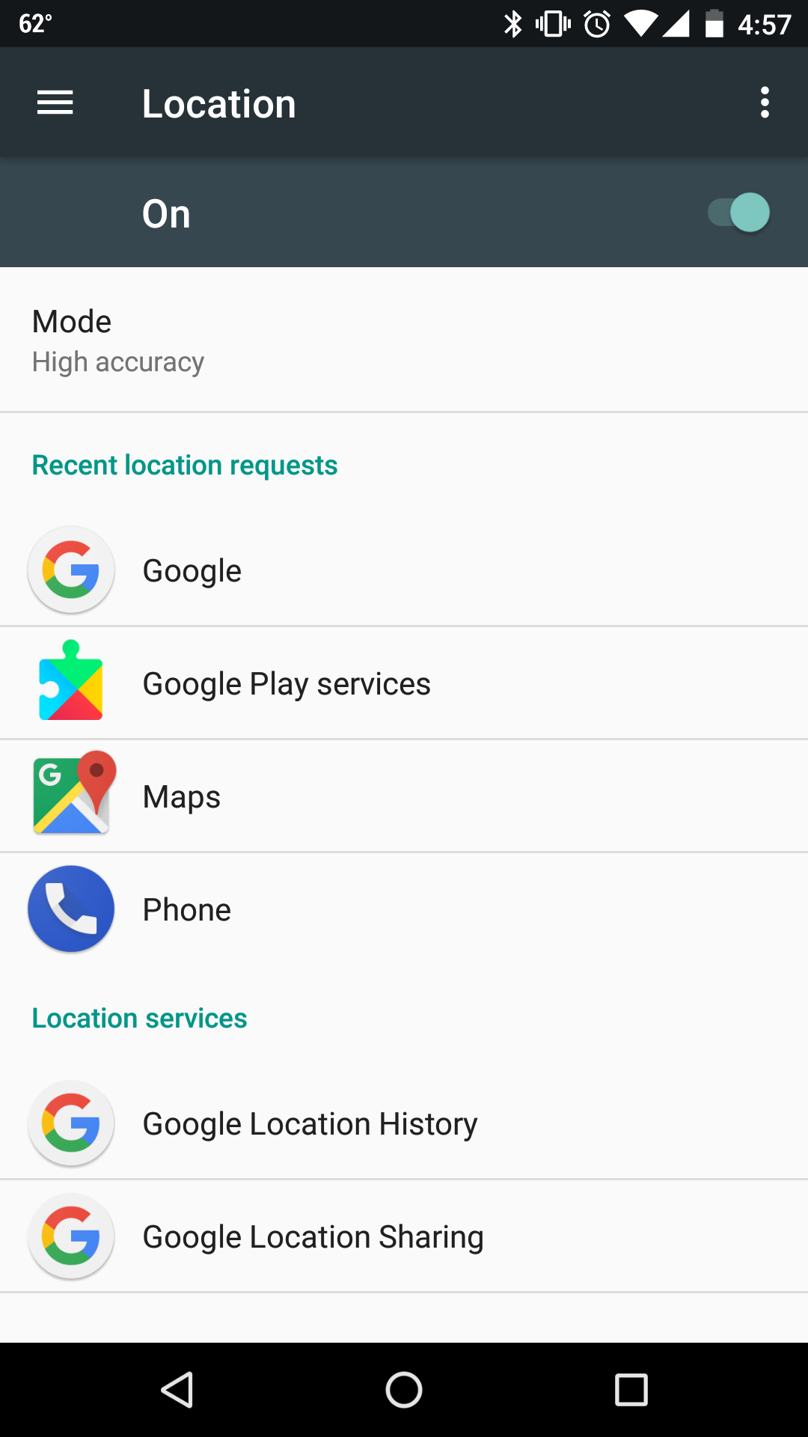
Location
Open your device’s Settings app
Tap Security & Location > Location.
If you don’t see “Security & Location,” tap Location
Turn Location on or off
Notes:
High accuracy
This mode uses GPS, Wi-Fi, mobile networks, and other sensors to get the highest-accuracy location. It uses Google's Location service to help estimate your device's location faster and more accurately.
Battery saving
This mode uses sources that use less battery, like Wi-Fi and mobile networks. It uses Google's Location service to help estimate your device's location faster and more accurately.
Device only
This mode uses only GPS. It doesn’t use Google's Location service to provide location information. It can estimate your device's location slower and use more battery.

Slide 6
Legend
Search bar
Menu
Microphone
You are here
Re-center
Get directions
Notes:
What’s what on the screen
Menu
Search bar
Microphone
Blue dot
Blue circle
Recenter thing
To see the map from your point of view, tap the compass.
Tap in the search bar
End on get directions – tap search bar

Slide 7
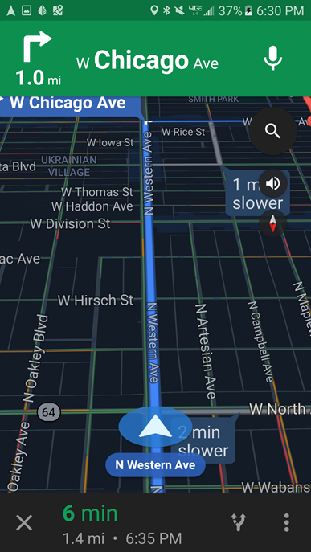
Legend
Your next move
Search along route
Mute/Unmute
Compass
You are here
Alternate route in gray
Estimated time remaining

Slide 8
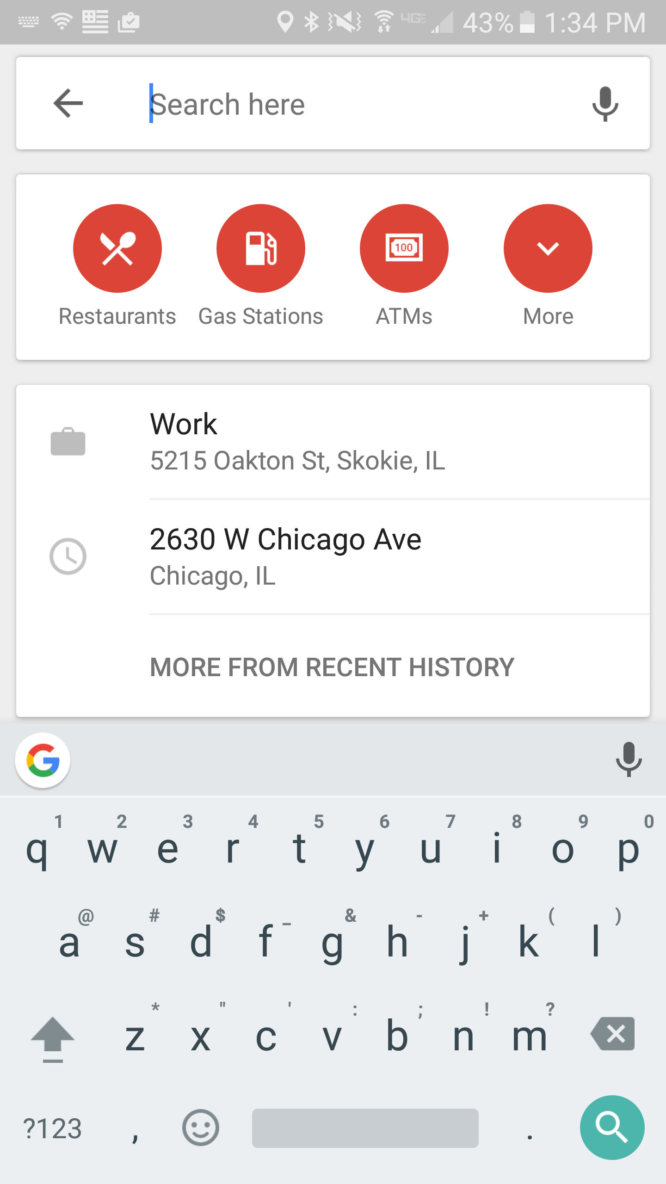
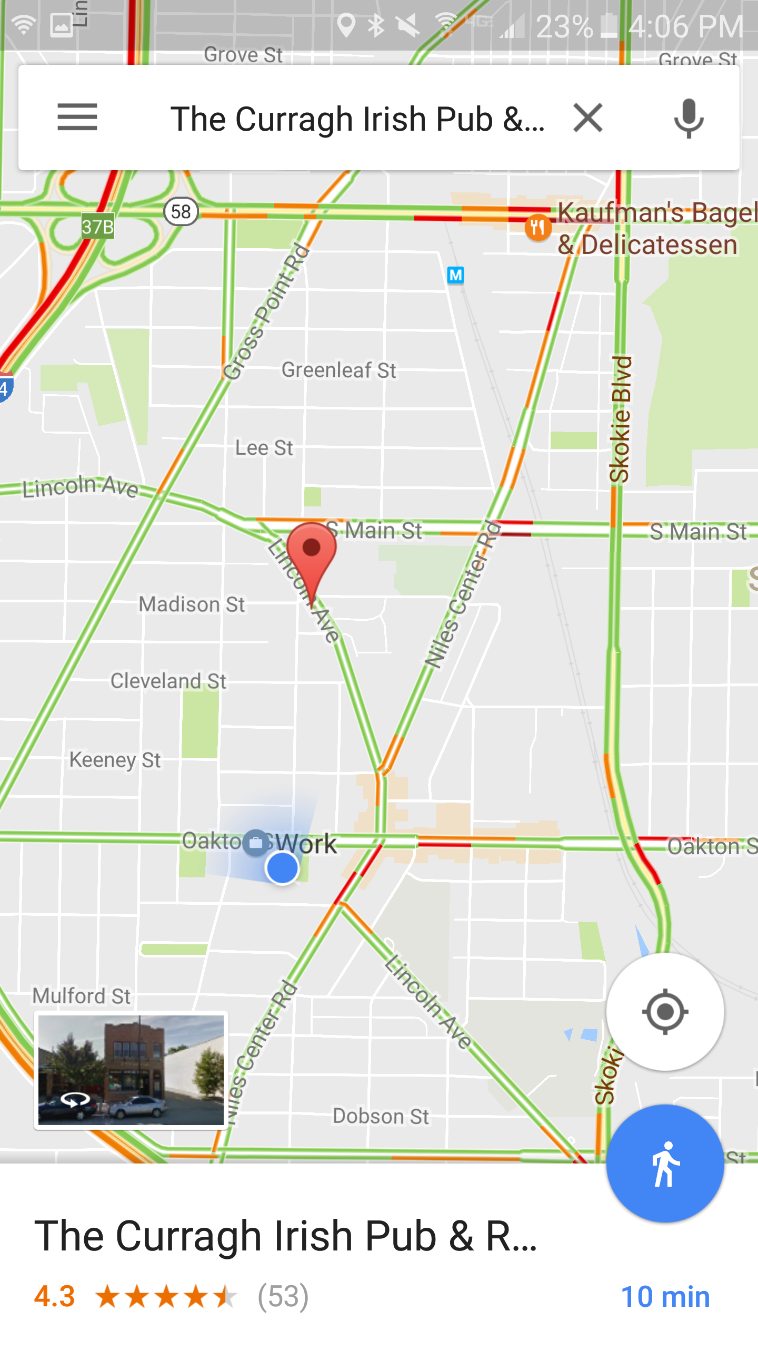
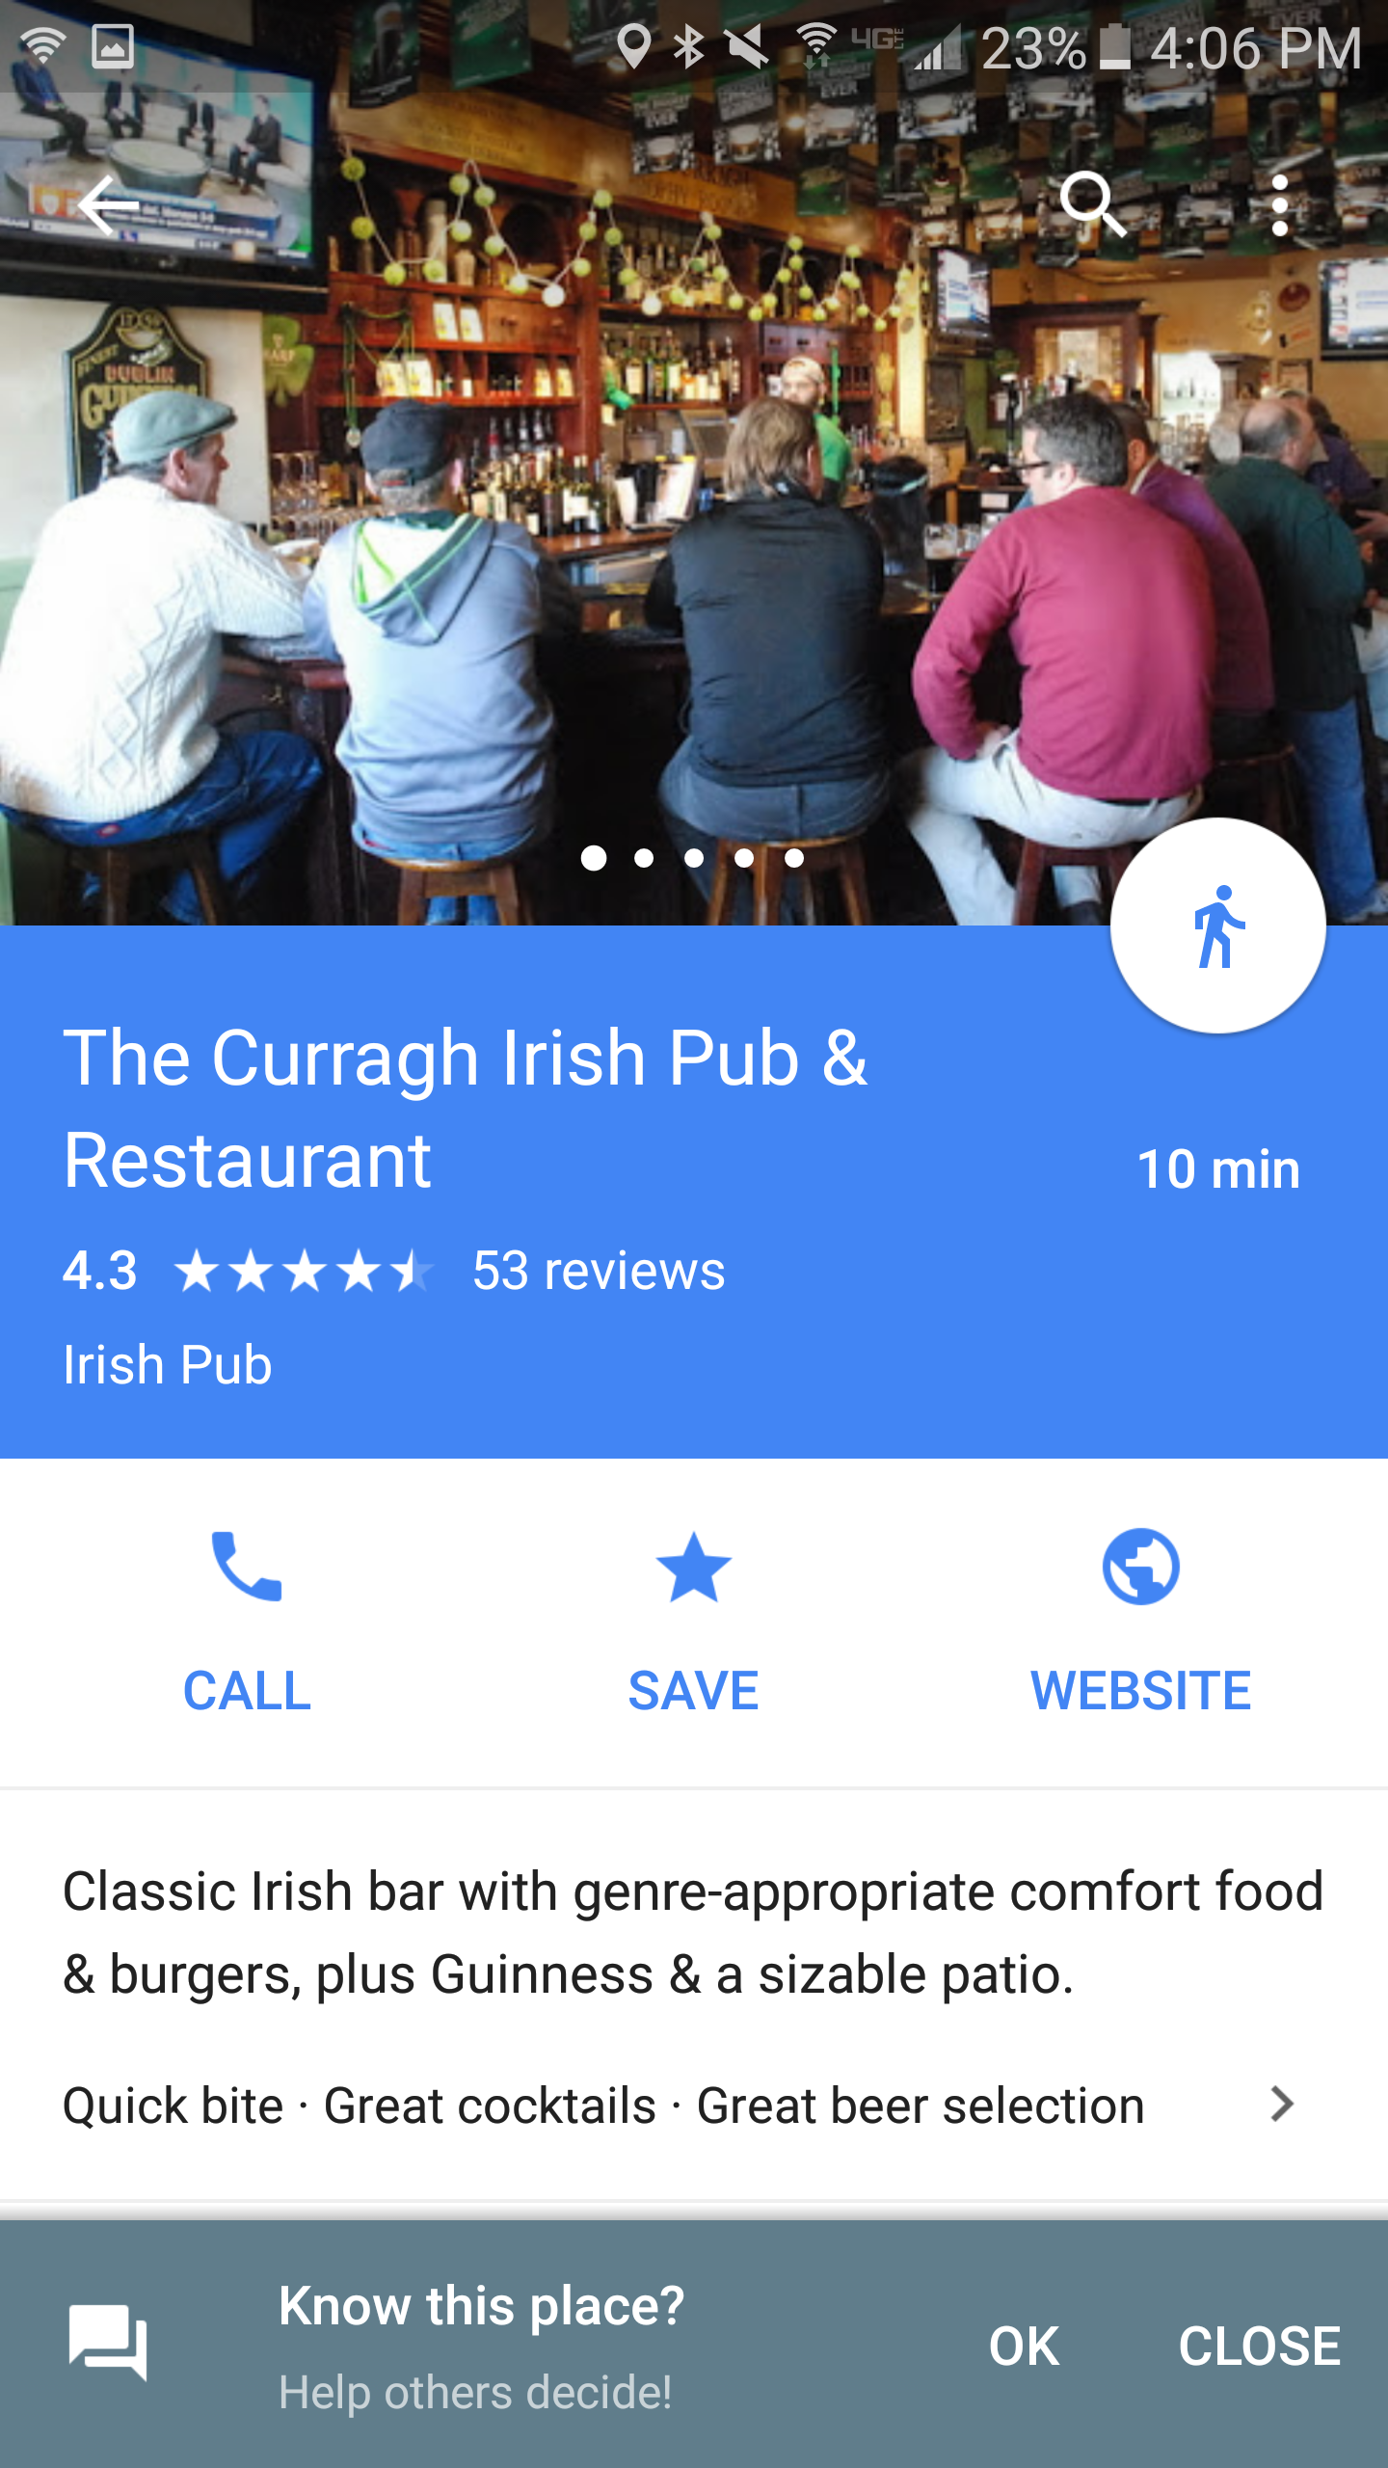
Find a Place
Notes:
Find places near you if you don’t know where you want to go
Tap in the search bar
Some info comes up:
Nearby restaurants, gas stations, atms…
Recent places
Select a place that sounds good to you
Will show you on the map where it is (and how long it will take to get there)
Swipe up for more info
Get some basic info, reviews, etc.

Slide 9
Another Legend
Driving
Transit
Walking
Rides
Cycling

Slide 10
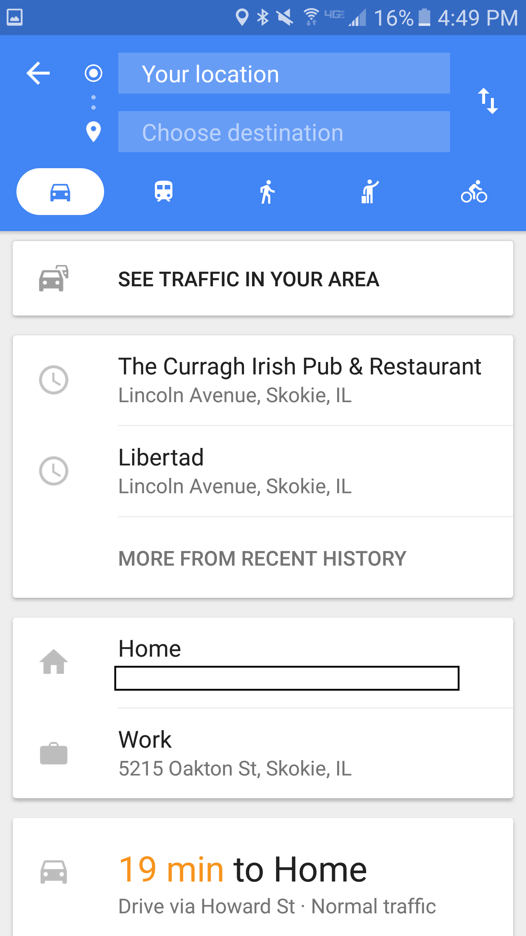
Navigate
Notes:
Tap on any one of the suggestions, or type in a destination
Chose mode of transportation
See traffic in your area
In the bottom right, tap the blue circle. It'll show a car, bus, bike, taxi, or person walking. If you touch and hold the blue circle instead, you’ll start navigation

Slide 11
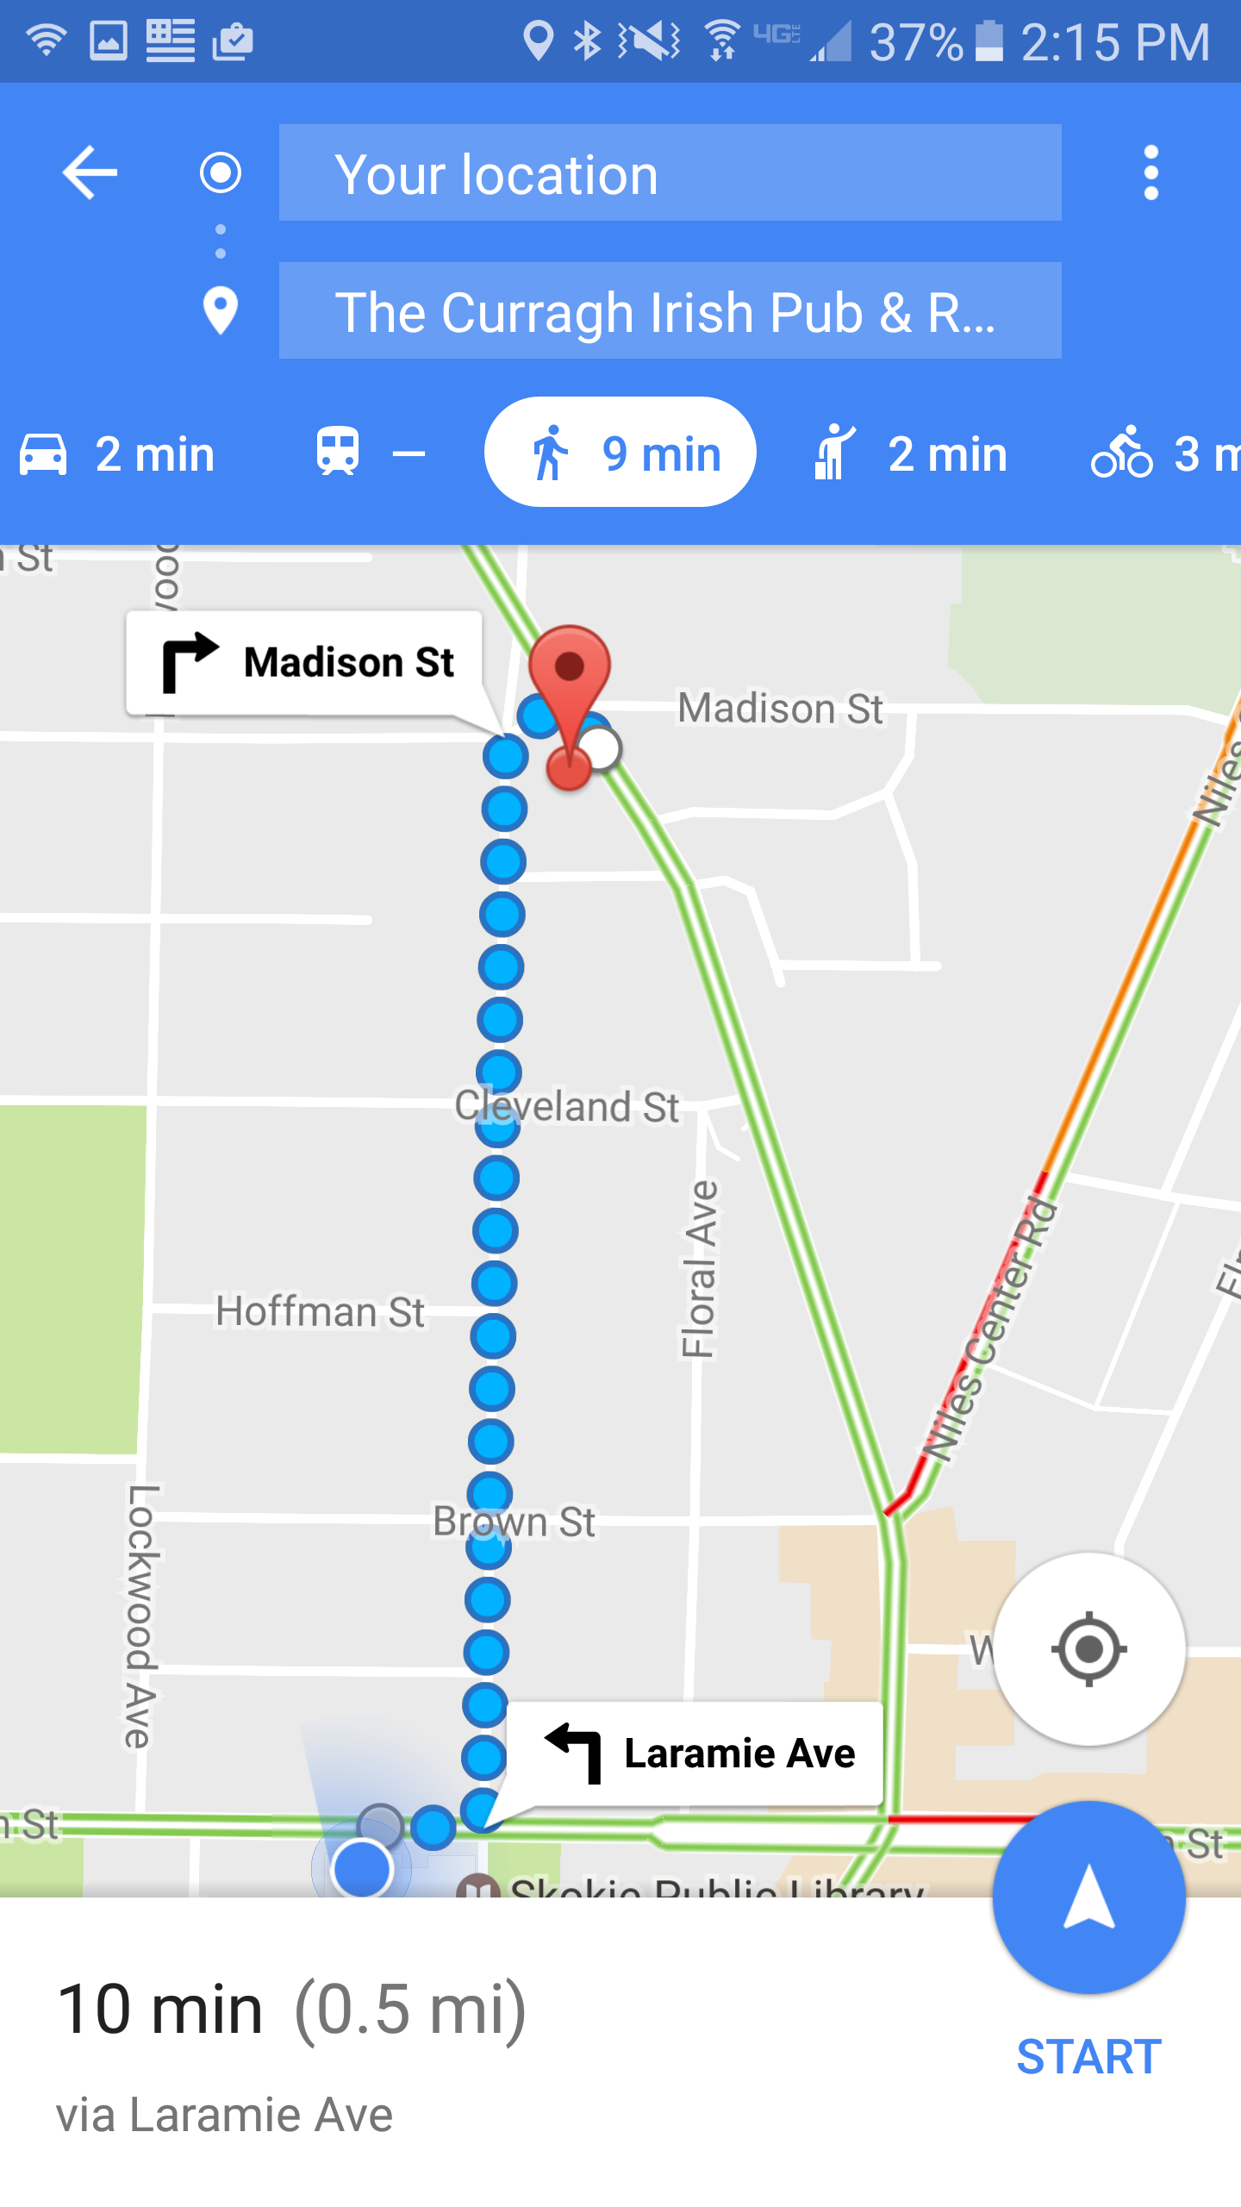
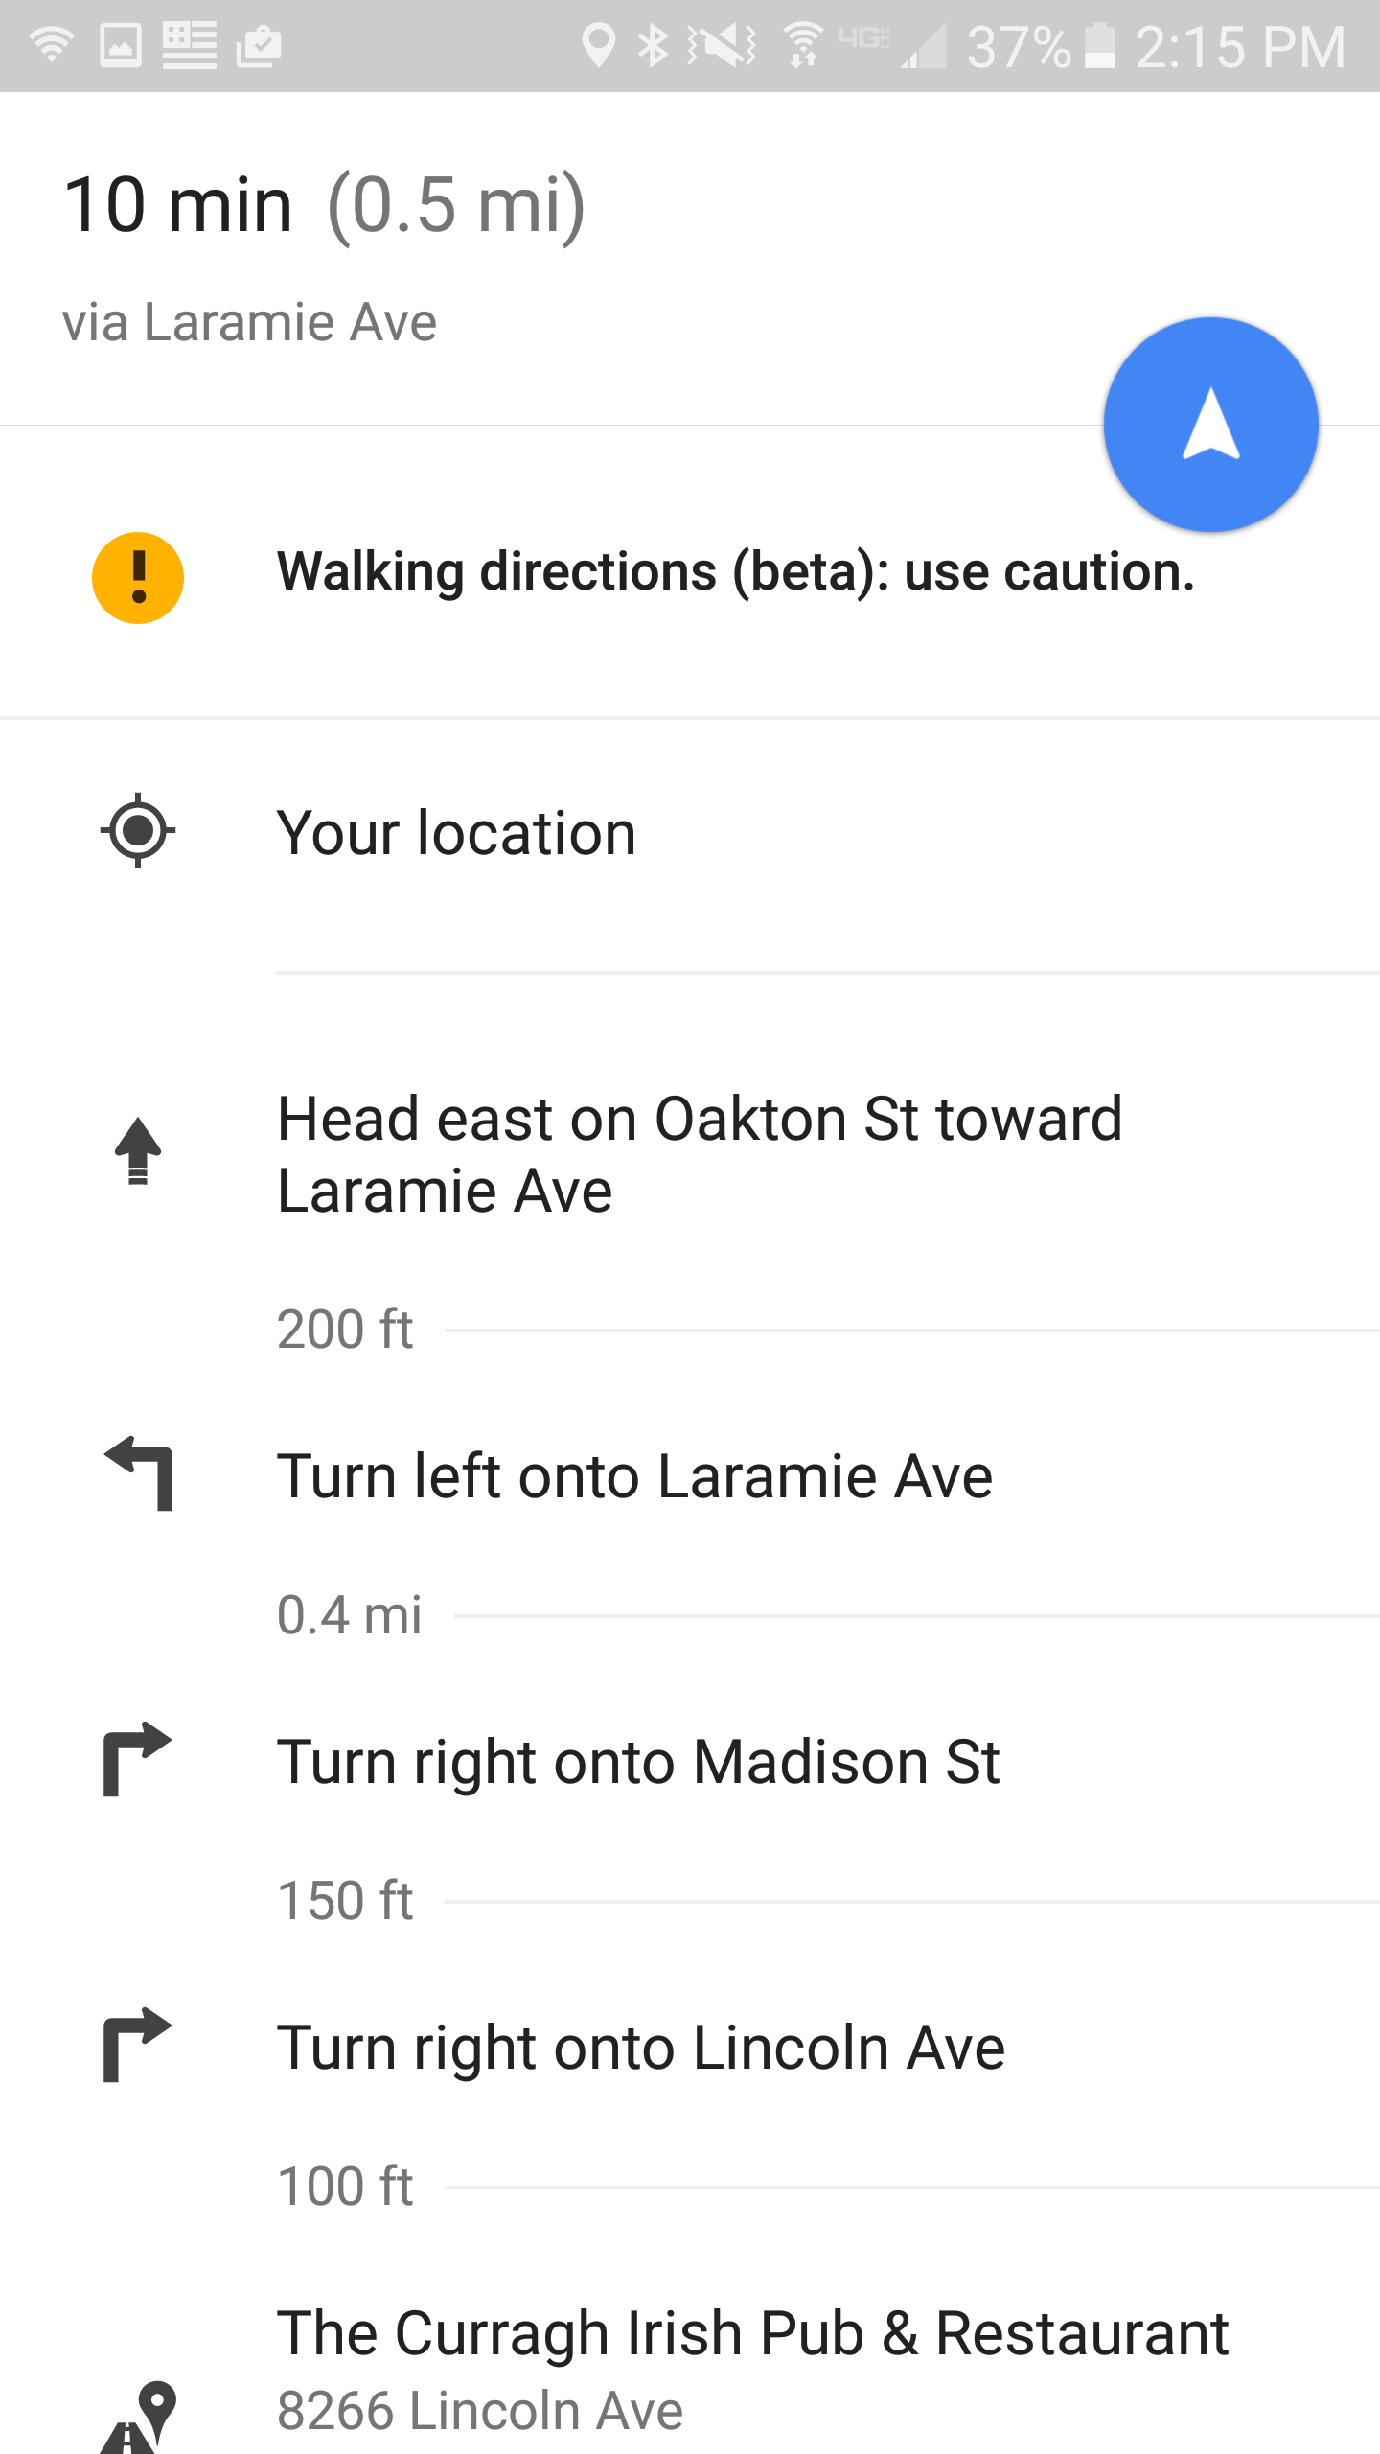
Navigate
Notes:
To see a step-by-step list of directions, tap the white bar at the bottom.
You can add a shortcut to easily get directions to a place you travel to often, like work or home.
To switch between miles and kilometers, open the Google Maps app Menu Settings Distance units Miles or Kilometers.

Slide 12
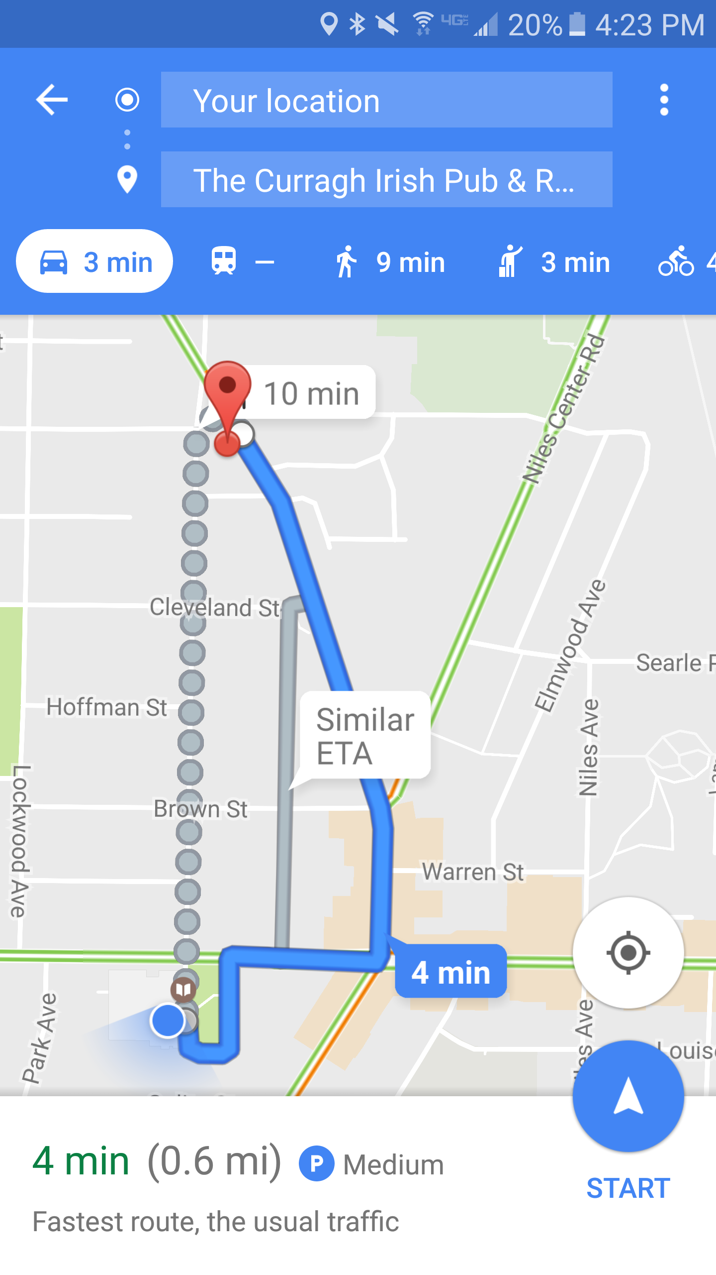
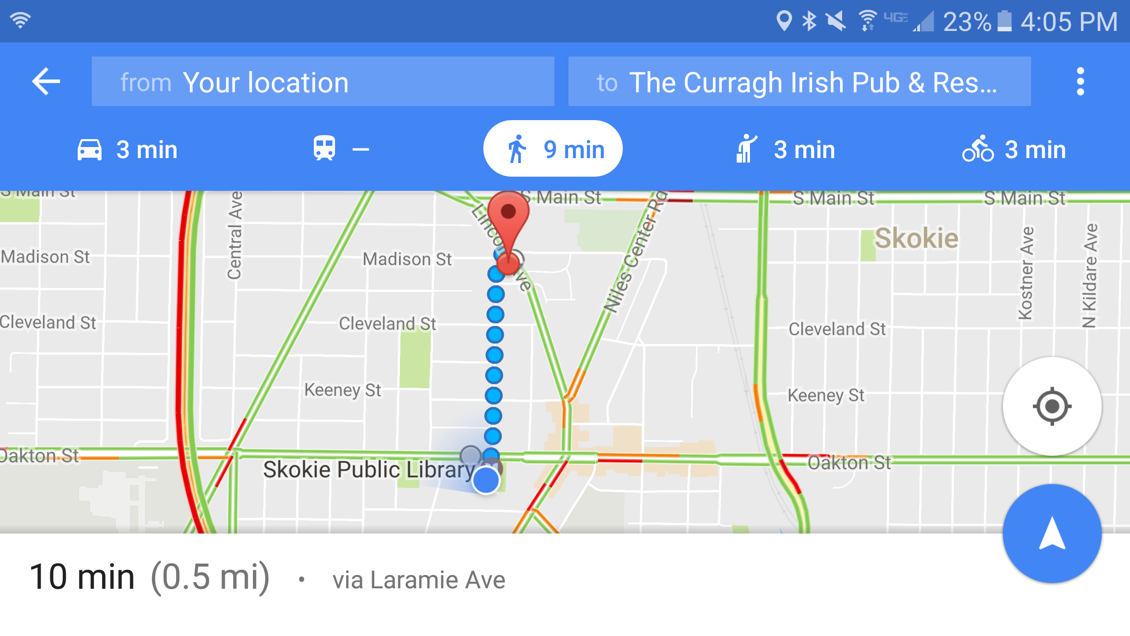
Navigate
Tap here to start navigation
Parking situation
Notes:
Optional: To add additional destinations, go to the top right and tap More Add stop. You can add up to 9 stops. When you are finished, tap Done.
Choose one of the following:
Driving:
Transit:
Walking:
Rides:
Cycling:
If alternate routes are available, they will be shown in gray on the map. To follow an alternate route, tap the gray line.
To start navigation, tap Navigate . If you see “Searching for GPS,” your phone is trying to get a GPS signal. For example, you might be in or near a tunnel, parking garage, or other location where there’s no GPS signal.

Slide 13
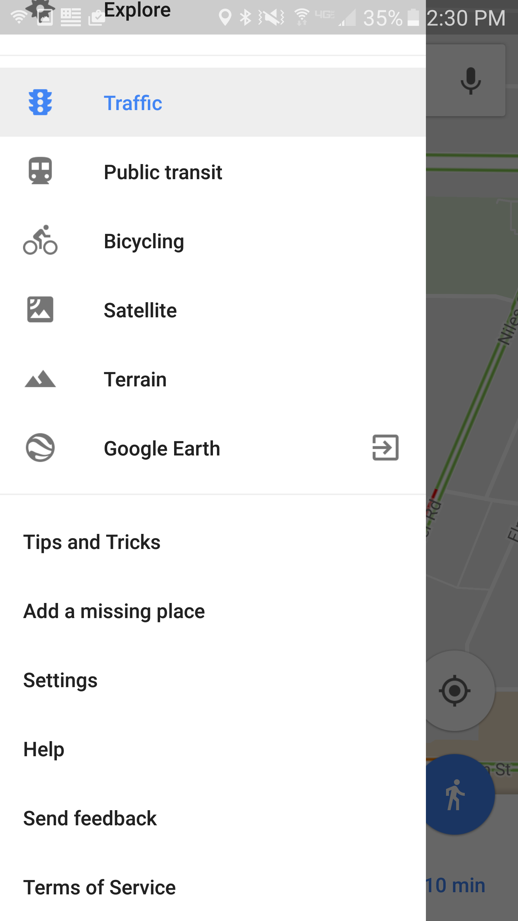
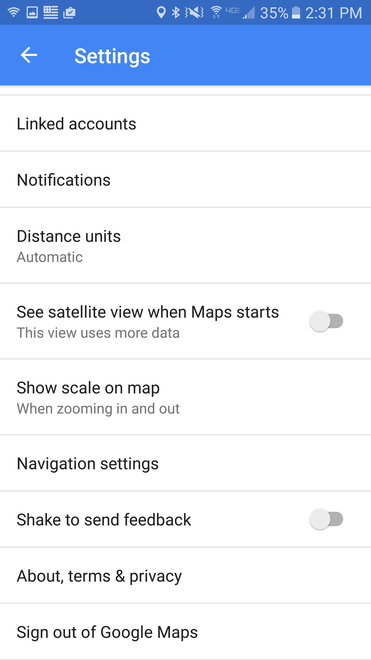
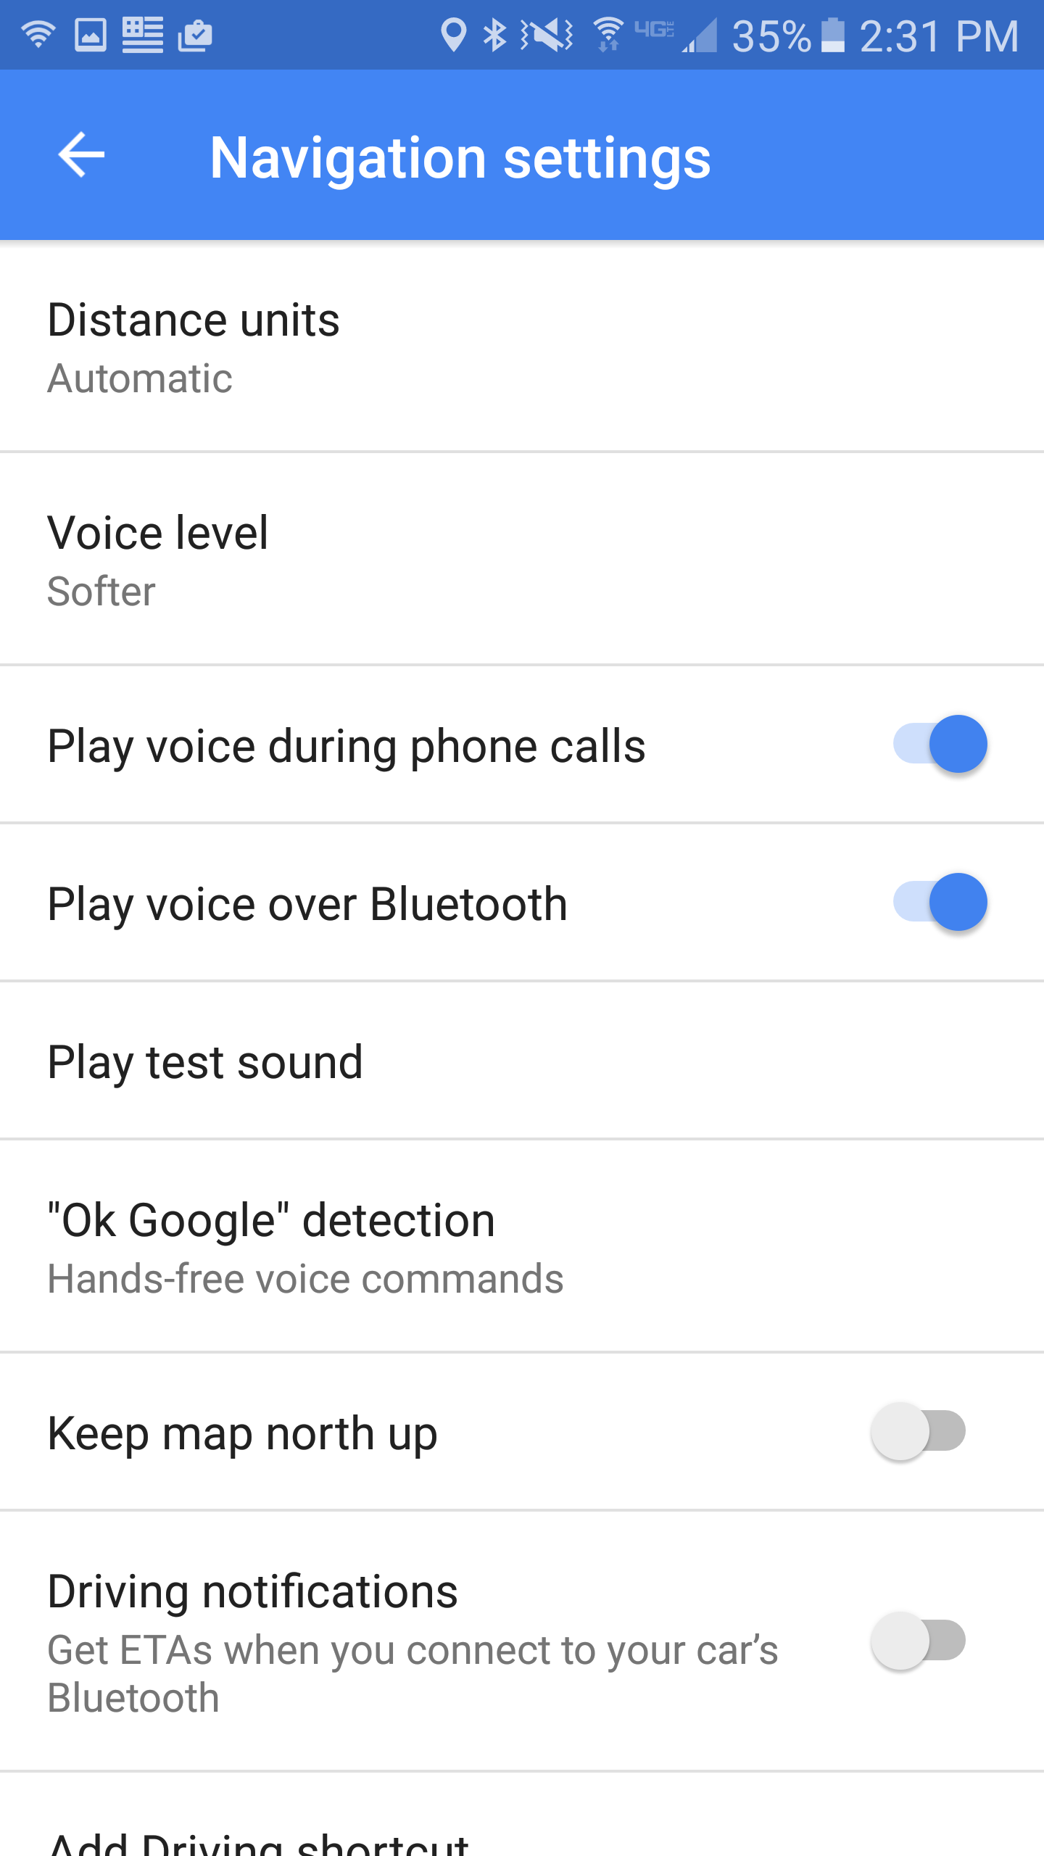
Voice Directions
Notes:
When you navigate to a place, you can hear voice directions.
Change the volume level
Open the Google Maps app Menu Settings Navigation settings Voice level.
Choose Louder, Normal, or Softer.
Mute, unmute, or hear alerts
Open the Google Maps app .
Start navigation.
In the top right, tap Sound . Then, choose one of the following:
Mute: Tap Mute .
Hear alerts: Tap Alerts . You’ll hear alerts like traffic, construction, and accidents. You won’t hear turn-by-turn directions.
Unmute: Tap Mute Sound .

Slide 14
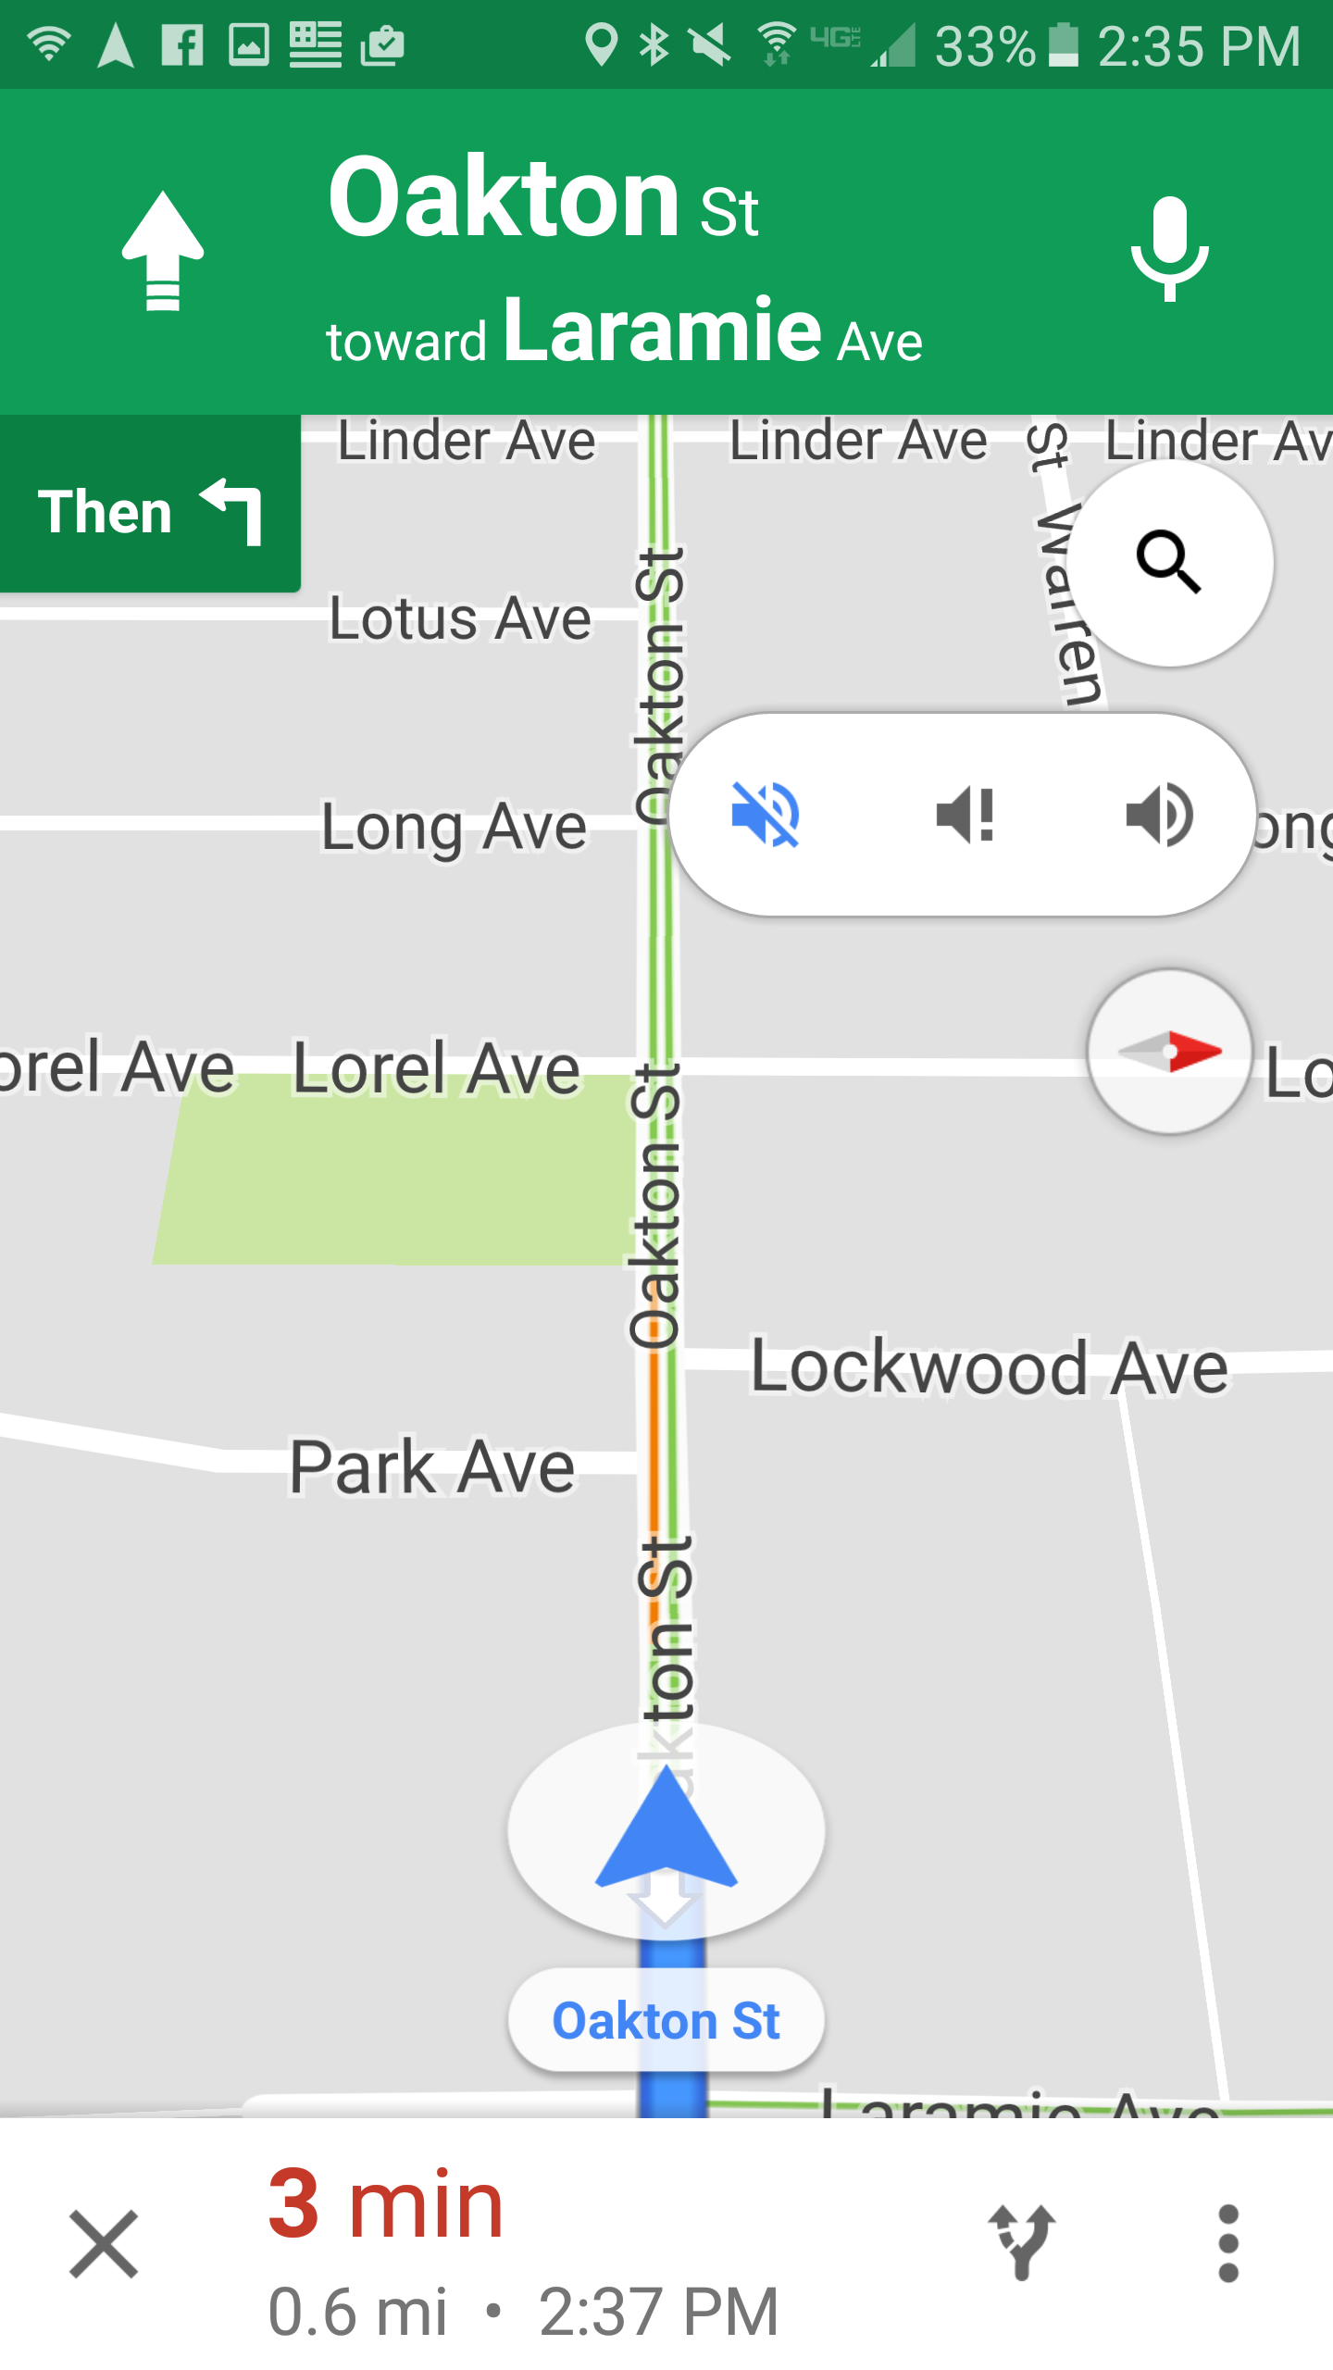
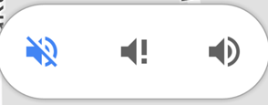
Voice Directions
ALERTS
MUTE ONLY UNMUTE
Notes:
Mute, unmute, or hear alerts
Open the Google Maps app .
Start navigation.
In the top right, tap Sound . Then, choose one of the following:
Mute: Tap Mute .
Hear alerts: Tap Alerts . You’ll hear alerts like traffic, construction, and accidents. You won’t hear turn-by-turn directions.
Unmute: Tap Mute Sound .

Slide 15
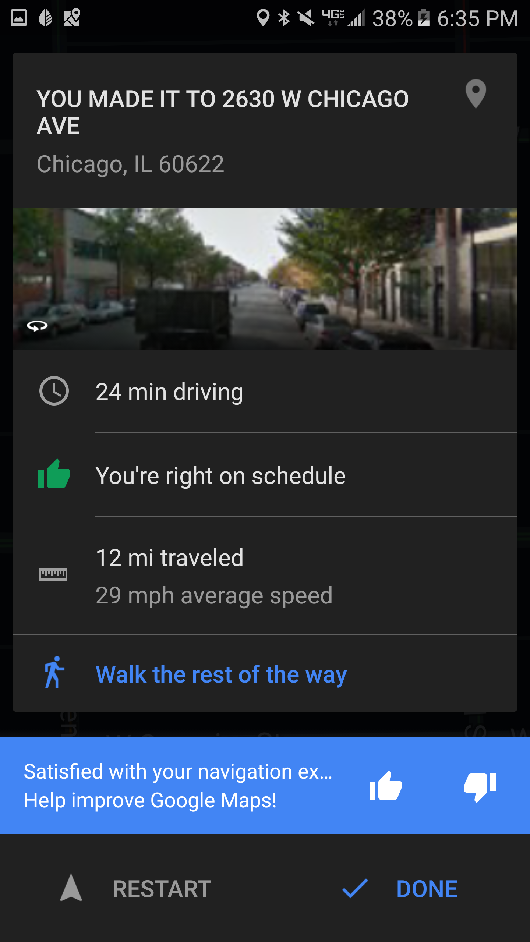
Stop Navigation
Tap here
to stop navigation while you’re still en route
Notes:
To stop or cancel navigation, go to the bottom left and tap Cancel X.

Slide 16
Save your home and work
Type less by saving your home and work addresses. And then shorten your commute by getting the fastest route.
Open the Google Maps app
Touch the Menu → Your Places → Enter home or work address

Slide 17
Thank You
Want a copy of this presentation?
Visit www.skokielibrary.info/handouts
where this presentation will be available
for four weeks.

